Slide 1


SCSA3016 DATA SCIENCE
UNIT -IV
Mrs. M. VANATHI
DEPARTMENT OF COMPUTER SCIENCE AND ENGINEERING

Slide 2
UNIT 4 MACHINE LEARNING TOOLS,
TECHNIQUES AND APPLICATIONS 9 Hrs.
Supervised Learning, Unsupervised Learning, Reinforcement Learning, Dimensionality Reduction, Principal Component Analysis, Classification and Regression models, Tree and Bayesian network models, Neural Networks, Testing, Evaluation and Validation of Models.

Slide 3
What is Learning?
Herbert Simon: “Learning is any process by which a system improves performance from experience.”
For a machine, experiences come in the form of data.
What is the task? Classification/Problem solving / planning / control
What does it mean to improve performance? Learning is guided by an objective- notion of Loss or Gain

Slide 4
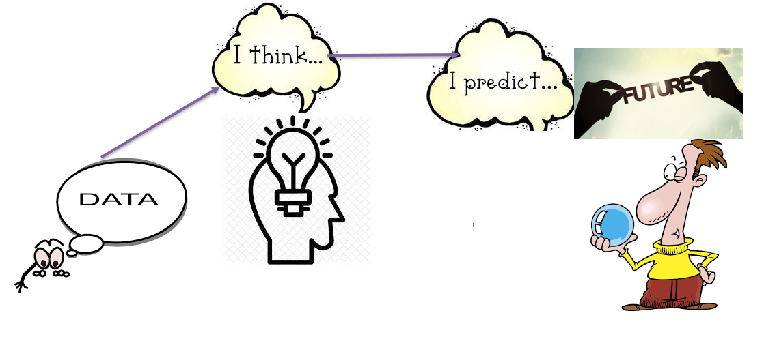
To do better in the future based on what was experienced in the past.

Slide 5
Why Machine Learning?
We need computers to make informed decisions on new, unseen data.
Often it is too difficult to design a set of rules “by hand”.
Machine learning is about automatically extracting relevant information from data and applying it to analyze new data.

Slide 6
Machine Learning - Definitions
Machine Learning - Field of study that gives computers the ability to learn without being explicitly programmed (Arthur Samuel 1959)
A branch of artificial intelligence, concerned with the design and development of algorithms that allow computers to evolve behaviors based on empirical data (experience)
Learning denotes changes in the system that are adaptive in the sense that they enable the system to do the same task ( or tasks drawn from a population of similar tasks) more effectively next time (H.Simon 1983)

Slide 7
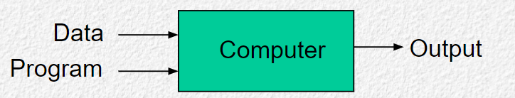
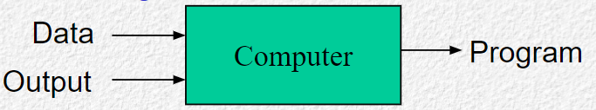
So What Is Machine Learning?
Traditional Programming
Machine Learning
Automating automation -Getting computers to program themselves
Writing software is the bottleneck -Let the data do the work instead!

Slide 8
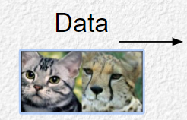
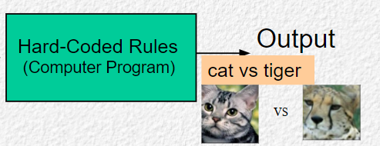
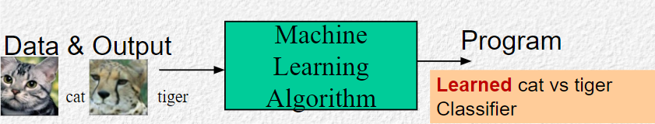
Contd.,
Traditional Programming : Write Programs using hard-coded (fixed) rules
Machine Learning : Learn Rules by looking at some training data

Slide 9
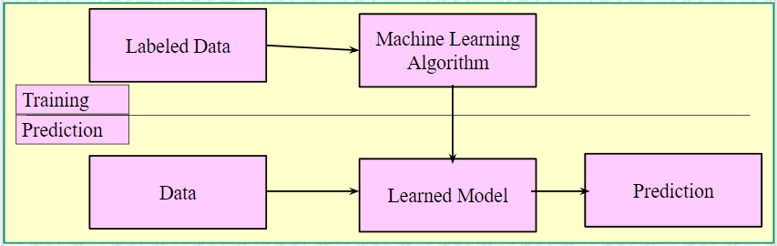
Machine Learning teams
Observe the world (Labeled Data)
Develop models that match observations
Teach computer to learn these models
Computer applies learned model to the world
Provides various techniques that can learn from and make predictions on data

Slide 10
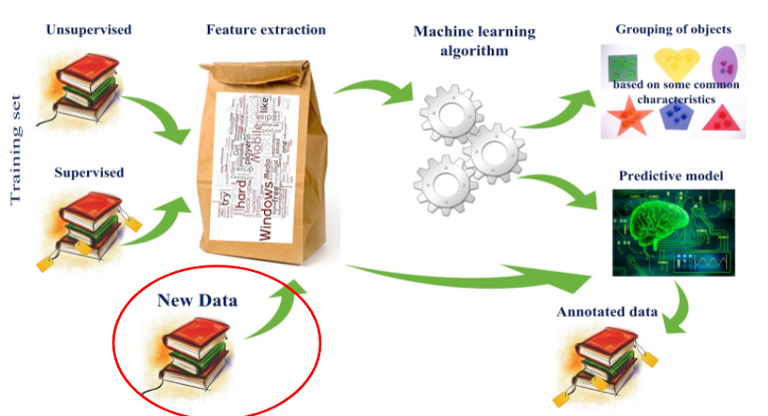
Machine Learning Workflow

Slide 11
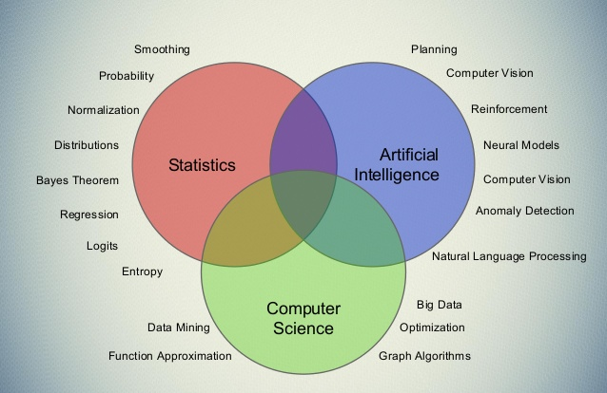

Slide 12
ML Terminology
Examples: Items or instances used for learning or evaluation.
Features: Set of attributes represented as a vector associated with an example.
Labels: Values or categories assigned to examples. In classification the labels are categories; in regression the labels are real numbers.
Target: The correct label for a training example. This is extra data that is needed for supervised learning.
Output: Prediction label from input set of features using a model of the machine learning algorithm.
Training sample: Examples used to train a machine learning algorithm.
Validation sample: Examples used to tune parameters of a learning algorithm.
Model: Information that the machine learning algorithm stores after training. The model is used when predicting the output labels of new, unseen examples.

Slide 13
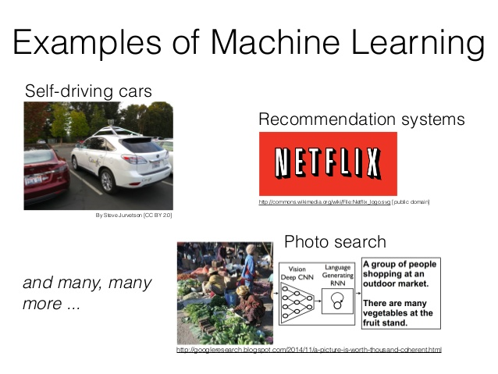

Slide 14
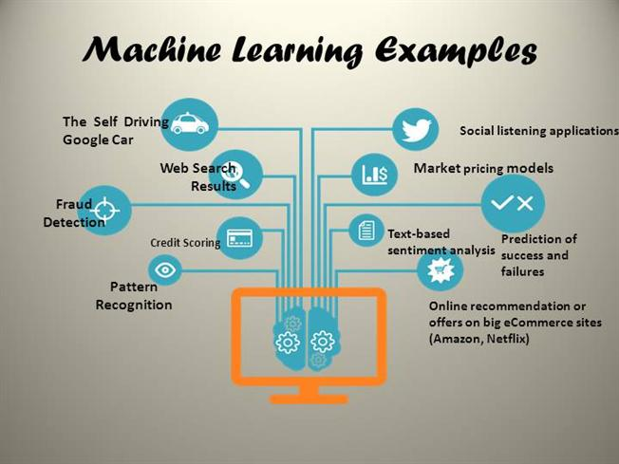

Slide 15
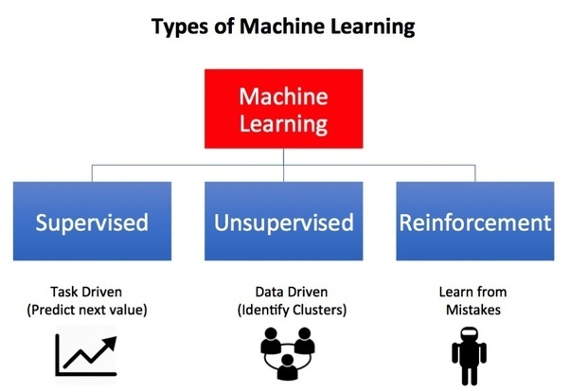

Slide 16
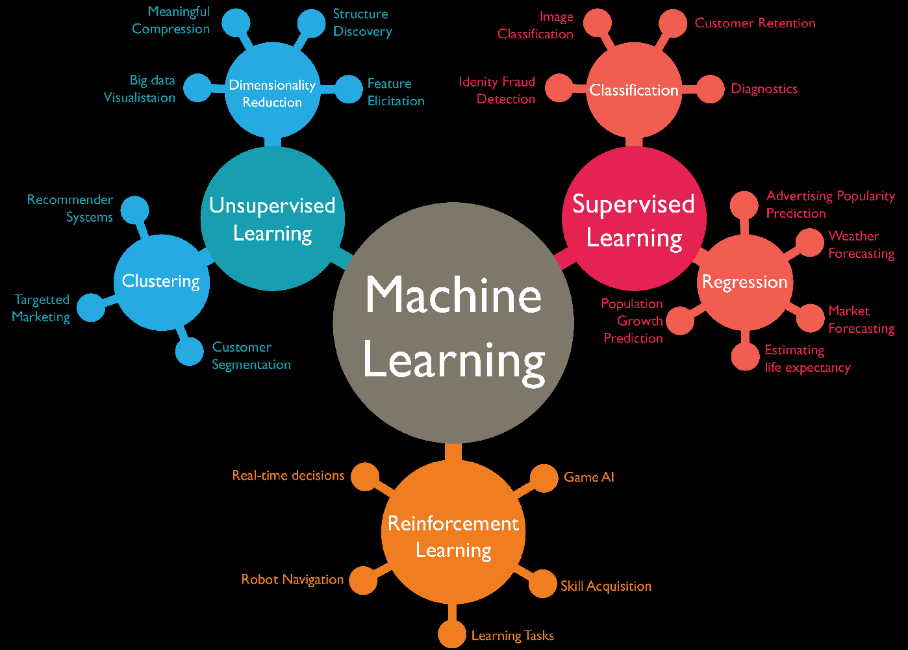

Slide 17
Key Elements of Machine Learning
Representation
how to represent knowledge
Evaluation
accuracy, prediction and recall, squared error, likelihood, posterior probability, cost, margin, entropy
Optimization
combinatorial optimization, convex optimization, constrained optimization

Slide 18
Machine Learning Areas
Supervised Learning: Data and corresponding labels are given
Unsupervised Learning: Only data is given, no labels provided
Semi-supervised Learning: Some (if not all) labels are present
Reinforcement Learning: An agent interacting with the world makes observations, takes actions, and is rewarded or punished; it should learn to choose actions in such a way as to obtain a lot of reward

Slide 19
Supervised Learning : Important Concepts
Data: labeled instances <x_{i}, y>, e.g. emails marked spam/not spam
Training Set
Held-out Set
Test Set
Features: attribute-value pairs which characterize each x
Experimentation cycle
Learn parameters (e.g. model probabilities) on training set
(Tune hyper-parameters on held-out set)
Compute accuracy of test set
Very important: never “peek” at the test set!
Evaluation
Accuracy: fraction of instances predicted correctly
Overfitting and generalization
Want a classifier which does well on test data
Overfitting: fitting the training data very closely, but not generalizing well

Slide 20
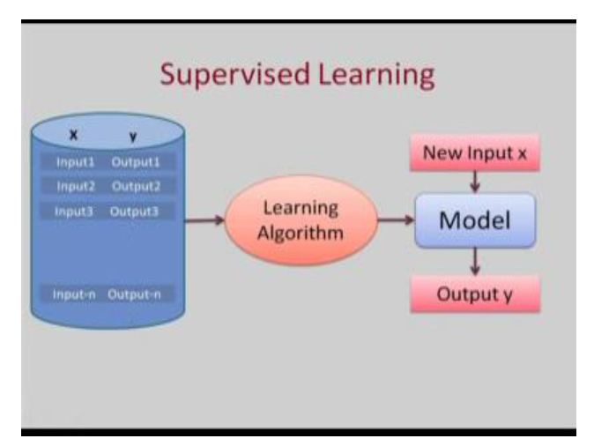

Slide 21
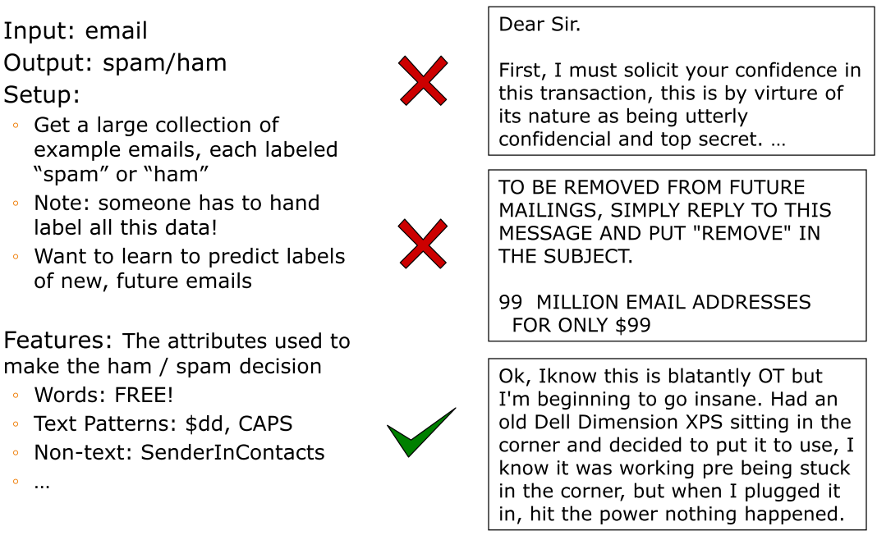
Example: Spam Filter

Slide 22
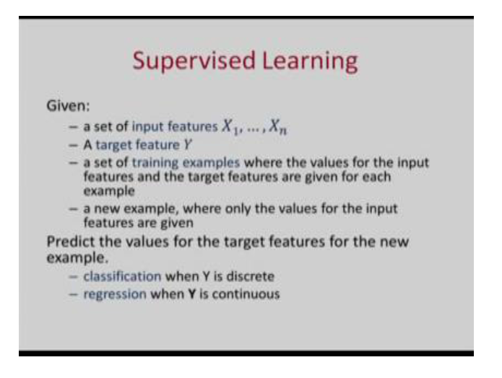

Slide 23
Classification
In classification, we predict labels y (classes) for inputs x
Examples:
OCR (input: images, classes: characters)
Medical diagnosis (input: symptoms, classes: diseases)
Automatic essay grader (input: document, classes: grades)
Fraud detection (input: account activity, classes: fraud / no fraud)
Customer service email routing
Recommended articles in a newspaper, recommended books
DNA and protein sequence identification
Categorization and identification of astronomical images
Financial investments
… many more

Slide 24
Inductive learning
Simplest form: learn a function from examples
f is the target function
An example is a pair (x, f(x))
Pure induction task:
Given a collection of examples of f, return a function h that approximates f.
find a hypothesis h, such that h ≈ f, given a training set of examples
(This is a highly simplified model of real learning:
Ignores prior knowledge
Assumes examples are given)

Slide 25
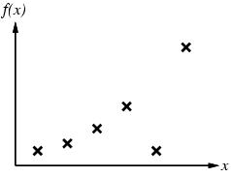
Inductive learning method
Construct/adjust h to agree with f on training set
(h is consistent if it agrees with f on all examples)
E.g., curve fitting:

Slide 26
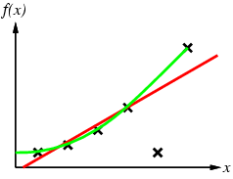
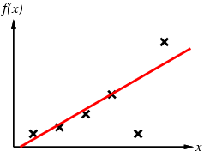
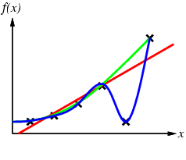
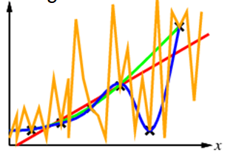
Contd.,

Slide 27
Supervised Learning
Learning a discrete function: Classification
Boolean classification:
Each example is classified as true(positive) or false(negative).
Learning a continuous function: Regression

Slide 28
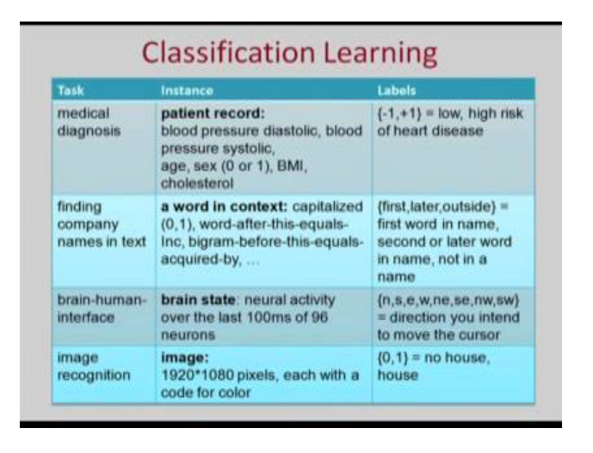

Slide 29
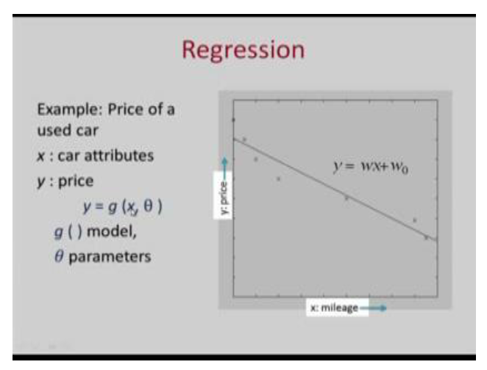

Slide 30
Applications of SL
Pattern recognition
Medical diagnosis
Speech recognition
Face recognition

Slide 31
Unsupervised Learning
In unsupervised learning, there is no such supervisor and we only have input data.
The aim is to find the regularities in the input. There is a structure to the input space such that certain patterns occur more often than others, and we want to see what generally happens and what does not.
In statistics, this is called density estimation. Trying to analyze with respect to input data.

Slide 32
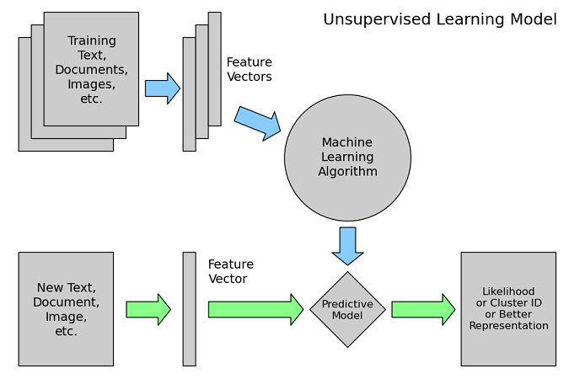

Slide 33
Types of USL….
Dimension reduction
Clustering
Association analysis ( e-commerce - recommendation engine).

Slide 34
scenario
A company with a data of past customers, the customer data contains the demographic information as well as the past transactions with the company, and the company may want to see the distribution of the profile of its customers, to see what type of customers frequently occur.
In such a case, a clustering model allocates customers similar in their attributes to the same group, providing the company with natural groupings of its customers; this is called customer segmentation.

Slide 35
Reinforcement learning
Reinforcement learning is an area of Machine Learning. It is about taking suitable action to maximize reward in a particular situation.
It is employed by various software and machines to find the best possible behavior or path it should take in a specific situation.
Reinforcement learning differs from supervised learning in a way that in supervised learning the training data has the answer key with it so the model is trained with the correct answer itself whereas in reinforcement learning, there is no answer but the reinforcement agent decides what to do to perform the given task.

Slide 36
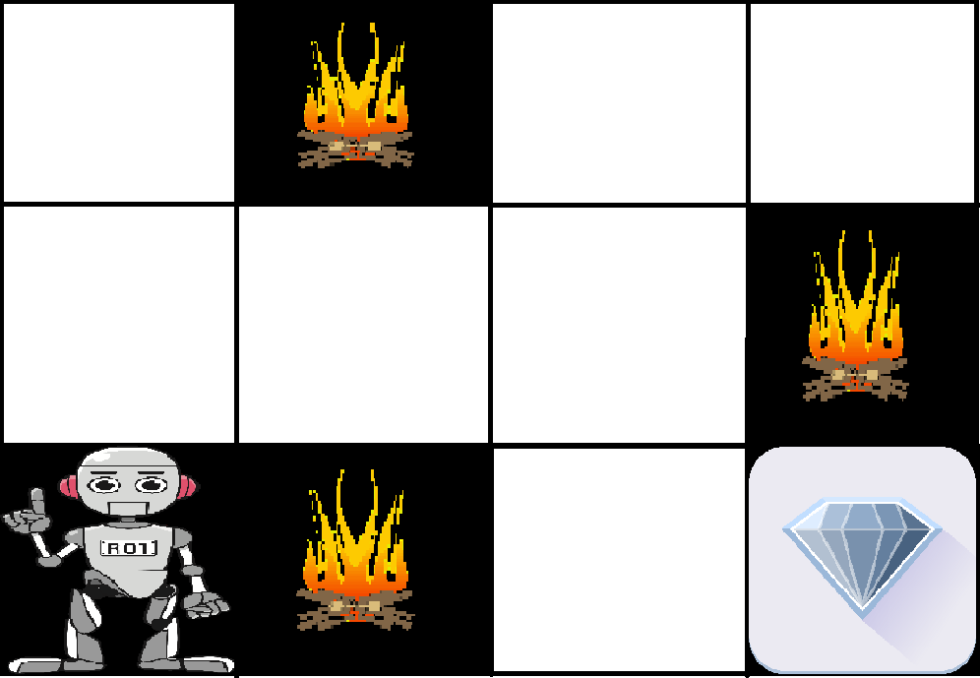
Example
The problem is as follows: We have an agent and a reward, with many hurdles in between. The agent is supposed to find the best possible path to reach the reward. The following problem explains the problem more easily.

Slide 37
Contd.,
The above image shows the robot, diamond, and fire. The goal of the robot is to get the reward that is the diamond and avoid the hurdles that are fired.
The robot learns by trying all the possible paths and then choosing the path which gives him the reward with the least hurdles.
Each right step will give the robot a reward and each wrong step will subtract the reward of the robot. The total reward will be calculated when it reaches the final reward that is the diamond.

Slide 38
REINFORCEMENT LEARNING | SUPERVISED LEARNING
Reinforcement learning is all about making decisions sequentially. In simple words, we can say that the output depends on the state of the current input and the next input depends on the output of the previous input | In Supervised learning, the decision is made on the initial input or the input given at the start
In Reinforcement learning decision is dependent, So we give labels to sequences of dependent decisions | In supervised learning the decisions are independent of each other so labels are given to each decision.
Example: Chess game | Example: Object recognition

Slide 39
Types of Reinforcement
Positive –
Positive Reinforcement is defined as when an event, occurs due to a particular behavior, increases the strength and the frequency of the behavior. In other words, it has a positive effect on behavior. Advantages of reinforcement learning are:
Maximizes Performance
Sustain Change for a long period of time
Too much Reinforcement can lead to an overload of states which can diminish the results

Slide 40
Contd.,
2. Negative –
Negative Reinforcement is defined as strengthening of behavior because a negative condition is stopped or avoided. Advantages of reinforcement learning:
Increases Behavior
Provide defiance to a minimum standard of performance
It Only provides enough to meet up the minimum behavior

Slide 41
Comparison Table
Criteria | Supervised ML | Unsupervised ML | Reinforcement ML
Definition | Learns by using labelled data | Trained using unlabelled data without any guidance. | Works on interacting with the environment
Type of data | Labelled data | Unlabelled data | No – predefined data
Type of problems | Regression and classification | Association and Clustering | Exploitation or Exploration
Supervision | Extra supervision | No supervision | No supervision
Algorithms | Linear Regression, Logistic Regression, SVM, KNN etc. | K – Means, C – Means, Apriori | Q – Learning, SARSA
Aim | Calculate outcomes | Discover underlying patterns | Learn a series of action
Application | Risk Evaluation, Forecast Sales | Recommendation System, Anomaly Detection | Self Driving Cars, Gaming, Healthcare

Slide 42
Dimensionality Reduction

Slide 43
Curse of Dimensionality
Increasing the number of features will not always improve classification accuracy.
In practice, the inclusion of more features might actually lead to worse performance.
The number of training examples required increases exponentially with dimensionality d (i.e., k^{d}).
k=3
3¹ bins
3² bins
3³ bins

Slide 44
Dimensionality Reduction
What is the objective?
Choose an optimum set of features of lower dimensionality to improve classification accuracy.
Different methods can be used to reduce dimensionality:
Feature extraction
Feature selection

Slide 45
Contd.,
Feature extraction: finds a set of new features (i.e., through some mapping f()) from the existing features.
Feature selection: chooses a subset of the original features.
The mapping f() could be linear or non-linear

Slide 46
Feature Extraction
Linear combinations are particularly attractive because they are simpler to compute and analytically tractable.
Given x ϵ R^{N}, find an K x N matrix T such that:
y = Tx ϵ R^{K} where K<<N
This is a projection from the N-dimensional space to a K-dimensional space.

Slide 47
Contd.,
Popular linear feature extraction methods:
Principal Components Analysis (PCA): Seeks a projection that preserves as much information in the data as possible.
Linear Discriminant Analysis (LDA): Seeks a projection that best discriminates the data.
Many other methods:
Making features as independent as possible (Independent Component Analysis or ICA).
Retaining interesting directions (Projection Pursuit).
Embedding to lower dimensional manifolds (Isomap, Locally Linear Embedding or LLE).

Slide 48
Vector Representation
A vector x ϵ R^{n} can be represented by n components:
Assuming the standard base <v₁, v₂, …, v_{N}> (i.e., unit vectors in each dimension), x_{i} can be obtained by projecting x along the direction of v_{i}:
x can be “reconstructed” from its projections as follows:
Since the basis vectors are the same for all x ϵ R^{n} (standard basis), we typically represent them as a n-component vector.

Slide 49
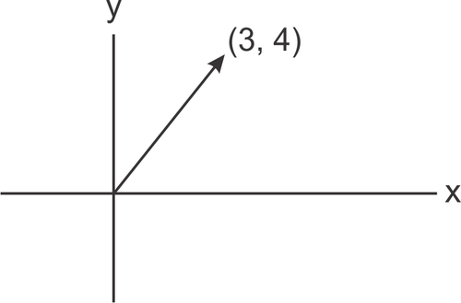
Contd.,
Example assuming n=2:
Assuming the standard base <v₁=i, v₂=j>, x_{i} can be obtained by projecting x along the direction of v_{i}:
x can be “reconstructed” from its projections as follows:

Slide 50
Principal Component Analysis (PCA)
If x∈R^{N}, then it can be written a linear combination of an orthonormal set of N basis vectors <v₁,v₂,…,v_{𝑁}> in R^{N} (e.g., using the standard base):
PCA seeks to approximate x in a subspace of R^{N} using a new set of K<<N basis vectors <u₁, u₂, …,u_{K}> in R^{N}:
such that is minimized!
(i.e., minimize information loss)
(reconstruction)

Slide 51
Principal Component Analysis (PCA)
The “optimal” set of basis vectors <u₁, u₂, …,u_{K}> can be found as follows (we will see why):
(1) Find the eigenvectors u_{𝑖} of the covariance matrix of the (training) data Σ_{x}
Σ_{x} u_{𝑖}= 𝜆_{𝑖} u_{𝑖}
(2) Choose the K “largest” eigenvectors u_{𝑖} (i.e., corresponding to the K “largest” eigenvalues 𝜆_{𝑖})
<u₁, u₂, …,u_{K}> correspond to the “optimal” basis!
We refer to the “largest” eigenvectors u_{𝑖} as principal components.

Slide 52
PCA - Steps
Suppose we are given x₁, x₂, ..., x_{M} (N x 1) vectors
Step 1: compute sample mean
Step 2: subtract sample mean (i.e., center data at zero)
Step 3: compute the sample covariance matrix Σ_{x}
N: # of features
M: # data
where A=[Φ₁ Φ₂ ... Φ_{Μ}]
i.e., the columns of A are the Φ_{i}
(N x M matrix)

Slide 53
PCA - Steps
Step 4: compute the eigenvalues/eigenvectors of Σ_{x}
Since Σ_{x} is symmetric, <u₁,u₂,…,u_{N}> form an orthogonal basis in R^{N} and we can represent any x∈R^{N} as:
where we assume
Note : most software packages return the eigenvalues (and corresponding eigenvectors) is decreasing order – if not, you can explicitly put them in this order)
i.e., this is
just a “change”
of basis!
Note : most software packages normalize u_{i} to unit length to simplify calculations; if not, you can explicitly normalize them)

Slide 54
PCA - Steps
Step 5: dimensionality reduction step – approximate x using only the first K eigenvectors (K<<N) (i.e., corresponding to the K largest eigenvalues where K is a parameter):
approximate using first K
Eigenvectors only
(reconstruction)
note that if K=N, then
(i.e., zero reconstruction error)

Slide 55
What is the Linear Transformation implied by PCA?
The linear transformation y = Tx which performs the dimensionality reduction in PCA is:
i.e., the columns of U are the
the first K eigenvectors of Σ_{x}
T = U^{T}
K x N matrix
i.e., the rows of T are the first K eigenvectors of Σ_{x}

Slide 56
What is the form of Σ_{y} ?
Using diagonalization:
The diagonal elements of
Λ are the eigenvalues of Σ_{X}
or the variances
The columns of P are the eigenvectors of Σ_{X}
PCA de-correlates the data!
Preserves original variances!

Slide 57
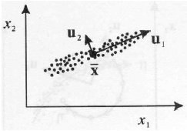
Interpretation of PCA
PCA chooses the eigenvectors of the covariance matrix corresponding to the largest eigenvalues.
The eigenvalues correspond to the variance of the data along the eigenvector directions.
Therefore, PCA projects the data along the directions where the data varies most.
PCA preserves as much information in the data by preserving as much variance in the data.
u₁: direction of max variance
u₂: orthogonal to u₁

Slide 58
Example
Compute the PCA of the following dataset:
(1,2),(3,3),(3,5),(5,4),(5,6),(6,5),(8,7),(9,8)
Compute the sample covariance matrix is:
The eigenvalues can be computed by finding the roots of the characteristic polynomial:

Slide 59
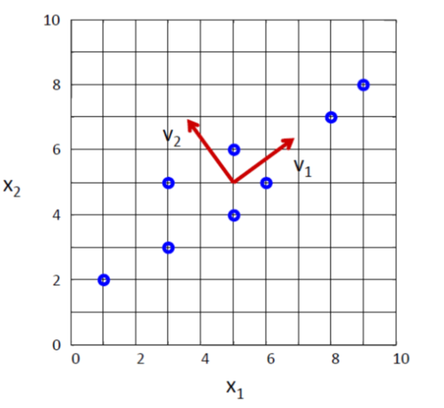
Contd.,
The eigenvectors are the solutions of the systems:
Note: if u_{i} is a solution, then cu_{i} is also a solution where c≠0.
Eigenvectors can be normalized to unit-length using:

Slide 60
How do we choose K ?
K is typically chosen based on how much information (variance) we want to preserve:
Choose the smallest K that satisfies the following inequality:
If T=0.9, for example, we “preserve” 90% of the information (variance) in the data.
If K=N, then we “preserve” 100% of the information in the data (i.e., just a “change” of basis and )

Slide 61
Approximation Error
The approximation error (or reconstruction error) can be computed by:
It can also be shown that the approximation error can be computed as follows:
where
(reconstruction)

Slide 62
Data Normalization
The principal components are dependent on the units used to measure the original variables as well as on the range of values they assume.
Data should always be normalized prior to using PCA.
A common normalization method is to transform all the data to have zero mean and unit standard deviation:
where μ and σ are the mean and standard
deviation of the i-th feature x_{i}

Slide 63
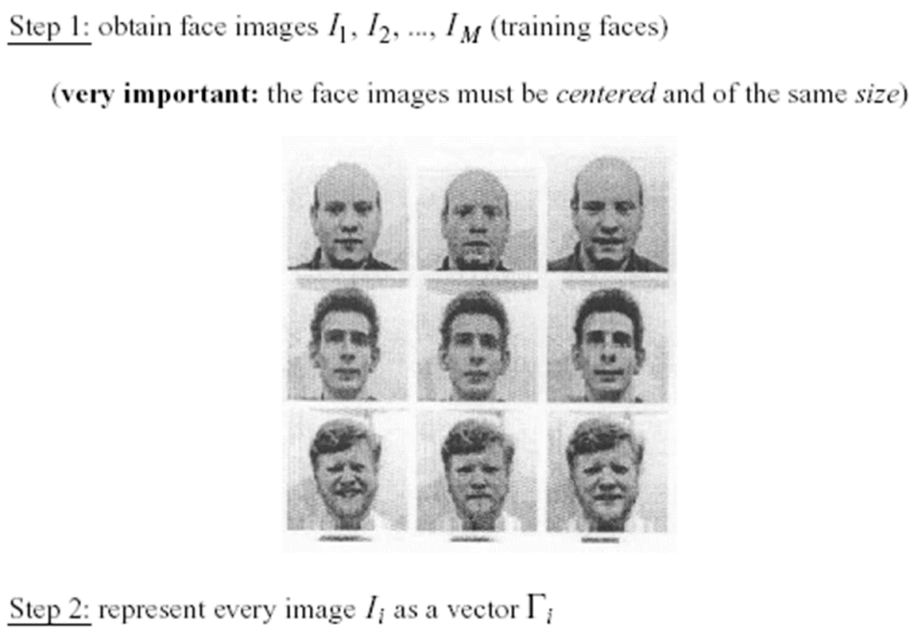
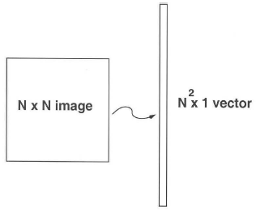
Application to Images
The goal is to represent images in a space of lower dimensionality using PCA.
Useful for various applications, e.g., face recognition, image compression, etc.
Given M images of size N x N, first represent each image as a 1D vector (i.e., by stacking the rows together).
Note that for face recognition, faces must be centered and of the same size.

Slide 64
Application to Images Contd.,
The key challenge is that the covariance matrix Σ_{x} is now very large (i.e., N² x N²) – see Step 3:
Step 3: compute the covariance matrix Σ_{x}
Σ_{x} is now an N² x N² matrix – computationally expensive to compute its eigenvalues/eigenvectors λ_{i}, u_{i}
(AA^{T})u_{i}= λ_{i}u_{i}
where A=[Φ₁ Φ₂ ... Φ_{Μ}] (N² x M matrix)

Slide 65
Application to Images Contd.,
We will use a simple “trick” to get around this by relating the eigenvalues/eigenvectors of AA^{T} to those of A^{T}A.
Let us consider the matrix A^{T}A instead (i.e., M x M matrix)
Suppose its eigenvalues/eigenvectors are μ_{i}, v_{i}
(A^{T}A)v_{i}= μ_{i}v_{i}
Multiply both sides by A:
A(A^{T}A)v_{i}=Aμ_{i}v_{i} or (AA^{T})(Av_{i})= μ_{i}(Av_{i})
Assuming (AA^{T})u_{i}= λ_{i}u_{i}
λ_{i}=μ_{i} and u_{i}=Av_{i}
A=[Φ₁ Φ₂ ... Φ_{Μ}] (N² x M matrix)

Slide 66
Application to Images Contd.,
But do AA^{T} and A^{T}A have the same number of eigenvalues/eigenvectors?
AA^{T} can have up to N² eigenvalues/eigenvectors.
A^{T}A can have up to M eigenvalues/eigenvectors.
It can be shown that the M eigenvalues/eigenvectors of A^{T}A are also the M largest eigenvalues/eigenvectors of AA^{T}
Steps 3-5 of PCA need to be updated as follows:

Slide 67
Application to Images Contd.,
Step 3: compute A^{T}A (i.e., instead of AA^{T})
Step 4: compute μ_{i}, v_{i} of A^{T}A
Step 4b: compute λ_{i}, u_{i} of AA^{T} using λ_{i}=μ_{i} and u_{i}=Av_{i}, then normalize u_{i} to unit length.
Step 5: dimensionality reduction step – approximate x using only the first K eigenvectors (K<M):
each image can be
represented by
a K-dimensional
vector

Slide 68
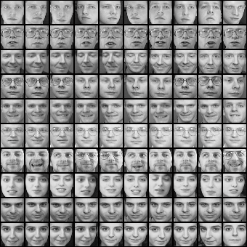
Example
Dataset

Slide 69
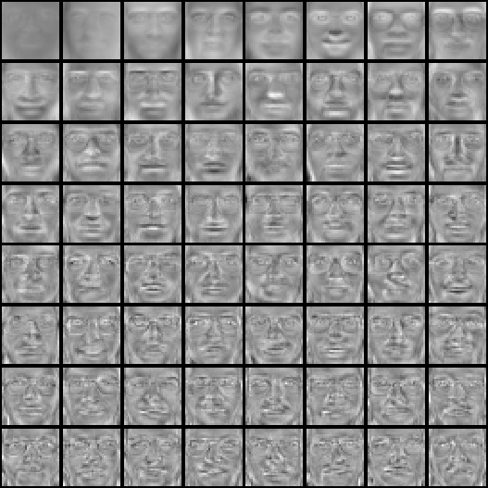

Example Contd.,
Top eigenvectors: u₁,…u_{k}
(visualized as an image - eigenfaces)

Slide 70
Example Contd.,
How can you visualize the eigenvectors (eigenfaces) as an image?
Their values must be first mapped to integer values in the interval [0, 255] (required by PGM format).
Suppose f_{min} and f_{max} are the min/max values of a given eigenface (could be negative).
If xϵ[f_{min}, f_{max}] is the original value, then the new value yϵ[0,255] can be computed as follows:
y=(int)255(x - f_{min})/(f_{max} - f_{min})

Slide 71
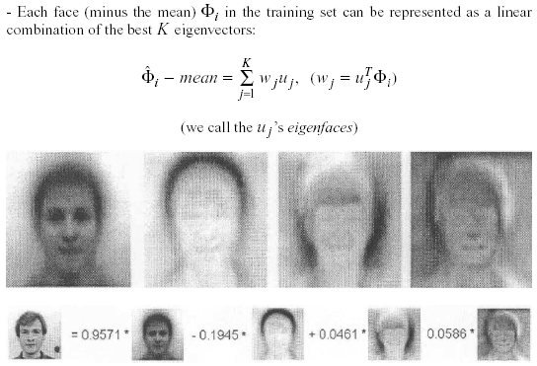
Example Contd.,
Interpretation: represent a face in terms of eigenfaces

Slide 72
Limitations
Background changes cause problems
- De-emphasize the outside of the face (e.g., by multiplying the input image by a 2D Gaussian window centered on the face).
Light changes degrade performance
- Light normalization might help but this is a challenging issue.
Performance decreases quickly with changes to face size
- Scale input image to multiple sizes.
- Multi-scale eigenspaces.
Performance decreases with changes to face orientation (but not as fast as with scale changes)
- Out-of-plane rotations are more difficult to handle.
- Multi-orientation eigenspaces.

Slide 73


Limitations contd.,
Not robust to misalignment

Slide 74
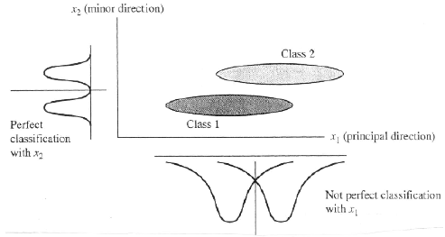
Limitations contd.,
PCA is not always an optimal dimensionality-reduction technique for classification purposes.

Slide 75
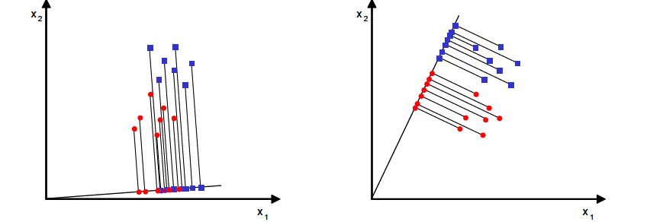
Linear Discriminant Analysis (LDA)
What is the goal of LDA?
Seeks to find directions along which the classes are best separated (i.e., increase discriminatory information).
It takes into consideration the scatter (i.e., variance) within-classes and between-classes.
Bad separability
Good separability

Slide 76
Linear Discriminant Analysis (LDA) Contd.,
Let us assume C classes with each class containing M_{i} samples, i=1,2,..,C and M the total number of samples:
Let μ_{i} is the mean of the i-th class, i=1,2,…,C and μ is the mean of the whole dataset:
Within-class scatter matrix
Between-class scatter matrix

Slide 77
Linear Discriminant Analysis (LDA) Contd.,
Suppose the desired projection transformation is:
Suppose the scatter matrices of the projected data y are:
LDA seeks transformations that maximize the between-class scatter and minimize the within-class scatter:
or

Slide 78
Linear Discriminant Analysis (LDA) Contd.,
It can be shown that the columns of the matrix U are the eigenvectors (i.e., called Fisherfaces) corresponding to the largest eigenvalues of the following generalized eigen-problem:
It can be shown that S_{b} has at most rank C-1; therefore, the max number of eigenvectors with non-zero eigenvalues is C-1, that is:
max dimensionality of LDA sub-space is C-1
e.g., when C=2, we always end up with one LDA feature no matter what the original number of features was!

Slide 79
Example

Slide 80
Linear Discriminant Analysis (LDA) Contd.,
If S_{w} is non-singular, we can solve a conventional eigenvalue problem as follows:
In practice, S_{w} is singular due to the high dimensionality of the data (e.g., images) and a much lower number of data (M << N )

Slide 81
Linear Discriminant Analysis (LDA) Contd.,
To alleviate this problem, PCA could be applied first:
First, apply PCA to reduce data dimensionality:
Then, apply LDA to find the most discriminative directions:

Slide 82
Classification

Slide 83
Classification—A Two-Step Process
Model construction: describing a set of predetermined classes
Each tuple/sample is assumed to belong to a predefined class, as determined by the class label
The set of tuples used for model construction is training set
The model is represented as classification rules, decision trees, or mathematical formulae
Model usage: for classifying future or unknown objects
Estimate accuracy of the model
The known label of test sample is compared with the classified result from the model
Test set is independent of training set, otherwise over-fitting will occur
If the accuracy is acceptable, use the model to classify data tuples whose class labels are not known

Slide 84
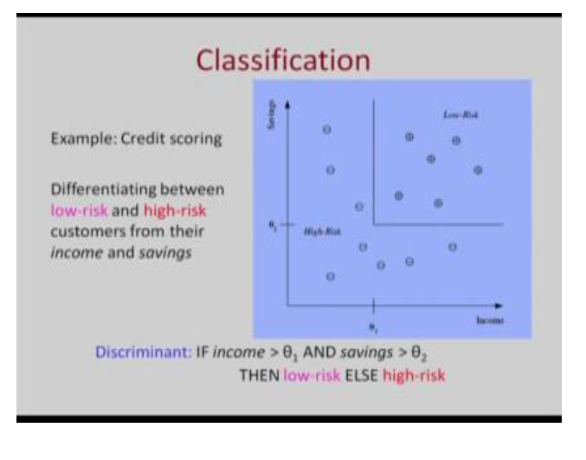

Slide 85
Illustrating Classification Task

Slide 86
Issues: Data Preparation
Data cleaning
Preprocess data in order to reduce noise and handle missing values
Relevance analysis (feature selection)
Remove the irrelevant or redundant attributes
Data transformation
Generalize data to (higher concepts, discretization)
Normalize attribute values

Slide 87
Classification Techniques
Decision Tree based Methods
Rule-based Methods
KNN
Naïve Bayes and Bayesian Belief Networks
Neural Networks
Support Vector Machines
and more...

Slide 88
Learning decision trees
Example Problem: decide whether to wait for a table at a restaurant, based on the following attributes:
Alternate: is there an alternative restaurant nearby?
Bar: is there a comfortable bar area to wait in?
Fri/Sat: is today Friday or Saturday?
Hungry: are we hungry?
Patrons: number of people in the restaurant (None, Some, Full)
Price: price range ($, $$, $$$)
Raining: is it raining outside?
Reservation: have we made a reservation?
Type: kind of restaurant (French, Italian, Thai, Burger)
WaitEstimate: estimated waiting time (0-10, 10-30, 30-60, >60)

Slide 89
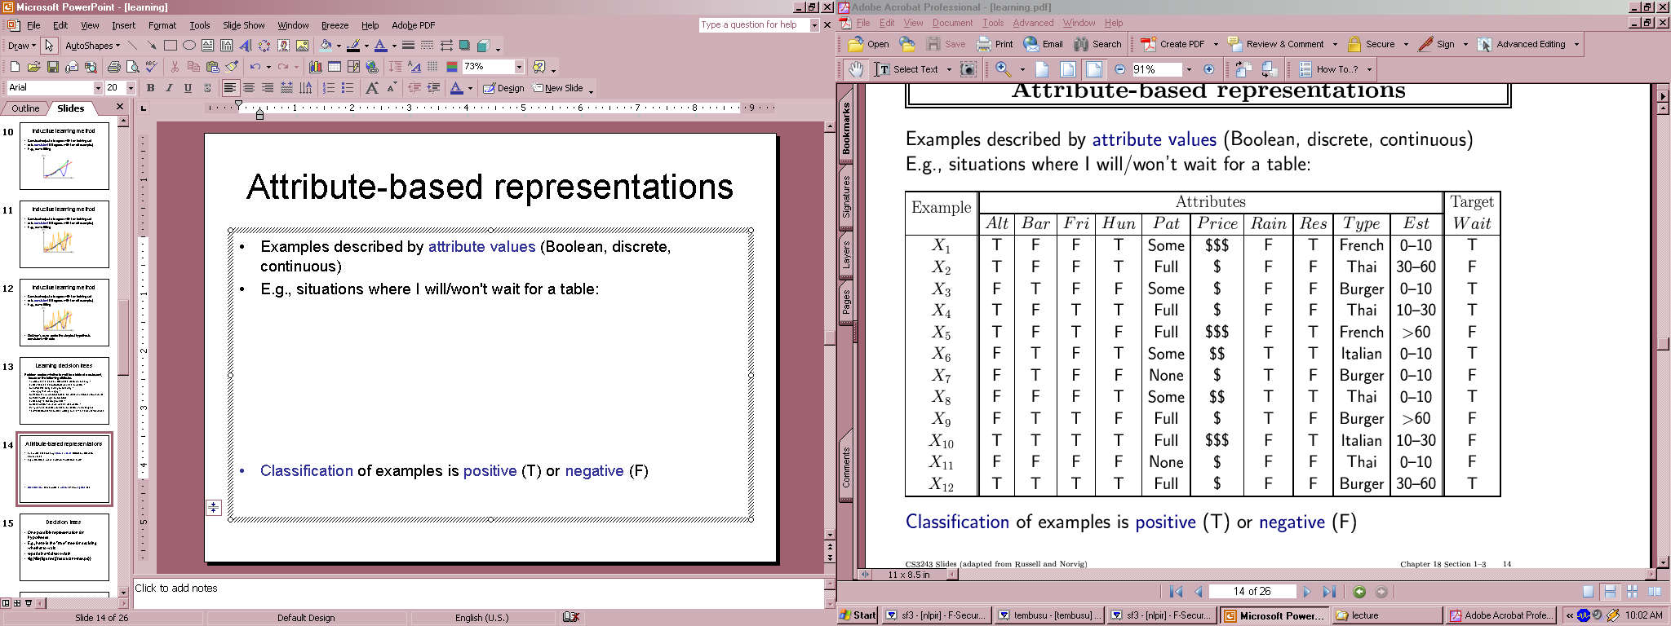
Feature(Attribute)-based representations
Examples described by feature(attribute) values
(Boolean, discrete, continuous)
E.g., situations where I will/won't wait for a table:
Classification of examples is positive (T) or negative (F)

Slide 90
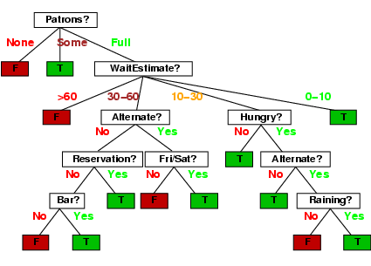
Decision trees
One possible representation for hypotheses
E.g., here is the “true” tree for deciding whether to wait:

Slide 91
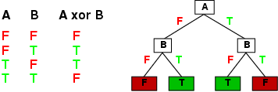
Expressiveness
Decision trees can express any function of the input attributes.
E.g., for Boolean functions, truth table row → path to leaf:
Trivially, there is a consistent decision tree for any training set with one path to leaf for each example (unless f nondeterministic in x) but it probably won't generalize to new examples
Prefer to find more compact decision trees

Slide 92
Rule-Based Classifier
Classify records by using a collection of “if…then…” rules
Rule: (Condition) → y
where
Condition is a conjunctions of attributes
y is the class label
LHS: rule antecedent or condition
RHS: rule consequent
Examples of classification rules:
(Blood Type=Warm) ∧ (Lay Eggs=Yes) → Birds
(Taxable Income < 50K) ∧ (Refund=Yes) → Evade=No

Slide 93
Rule-based Classifier (Example)
R1: (Give Birth = no) ∧ (Can Fly = yes) → Birds
R2: (Give Birth = no) ∧ (Live in Water = yes) → Fishes
R3: (Give Birth = yes) ∧ (Blood Type = warm) → Mammals
R4: (Give Birth = no) ∧ (Can Fly = no) → Reptiles
R5: (Live in Water = sometimes) → Amphibians

Slide 94
Rule Extraction from a Decision Tree
Rules are easier to understand than large trees
One rule is created for each path from the root to a leaf
Each attribute-value pair along a path forms a conjunction: the leaf holds the class prediction
age?
<=30
31..40
>40
student?
yes
credit rating?
no
yes
excellent
fair
no
yes
no
yes
Example: Rule extraction from our buys_computer decision-tree
IF age = young AND student = no THEN buys_computer = no
IF age = young AND student = yes THEN buys_computer = yes
IF age = mid-age THEN buys_computer = yes
IF age = old AND credit_rating = excellent THEN buys_computer = yes
IF age = young AND credit_rating = fair THEN buys_computer = no

Slide 95
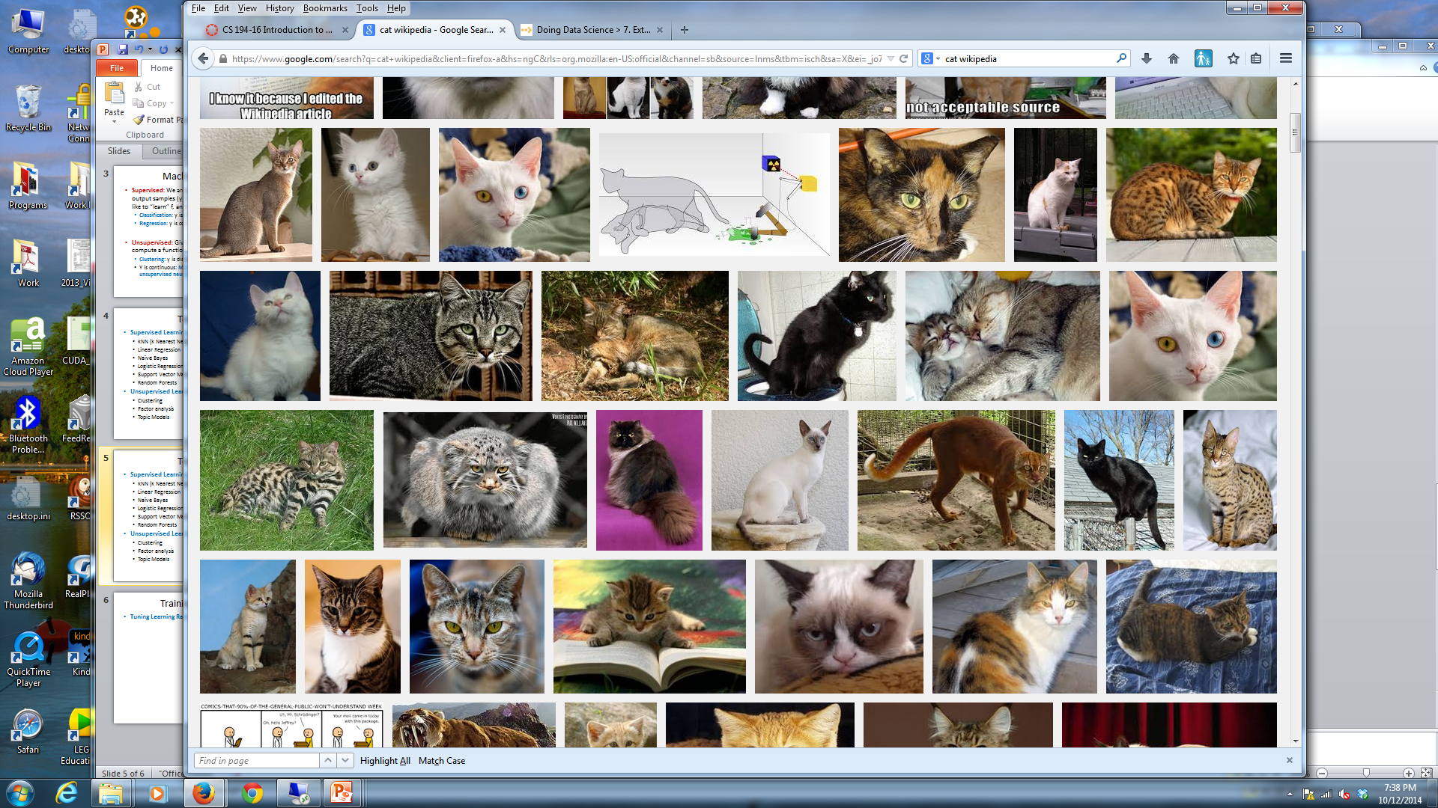
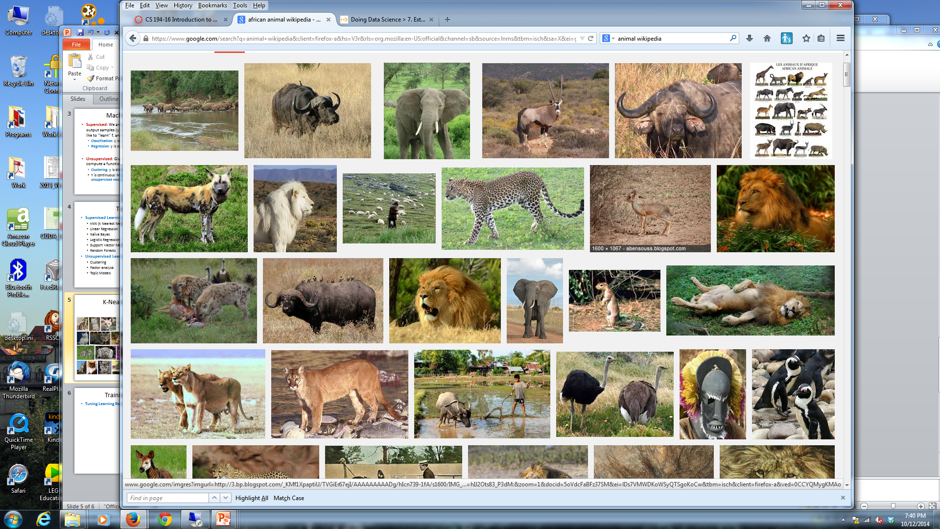
K-Nearest Neighbors
Given a query item: Find k closest matches in a labeled dataset ↓

Slide 96
K-Nearest Neighbors
Given a query item: Return the most Find k closest matches Frequent label

Slide 97
K-Nearest Neighbors
k = 3 votes for “cat”

Slide 98
K-Nearest Neighbors
2 votes for cat,
1 each for Buffalo, Cat wins…
Deer, Lion

Slide 99
K-NN Issues
The Data is the Model
No training needed.
Accuracy generally improves with more data.
Matching is simple and fast (and single pass).
Usually need data in memory, but can be run off disk.
Minimal Configuration:
Only parameter is k (number of neighbors)
Two other choices are important:
Weighting of neighbors (e.g. inverse distance)
Similarity metric

Slide 100
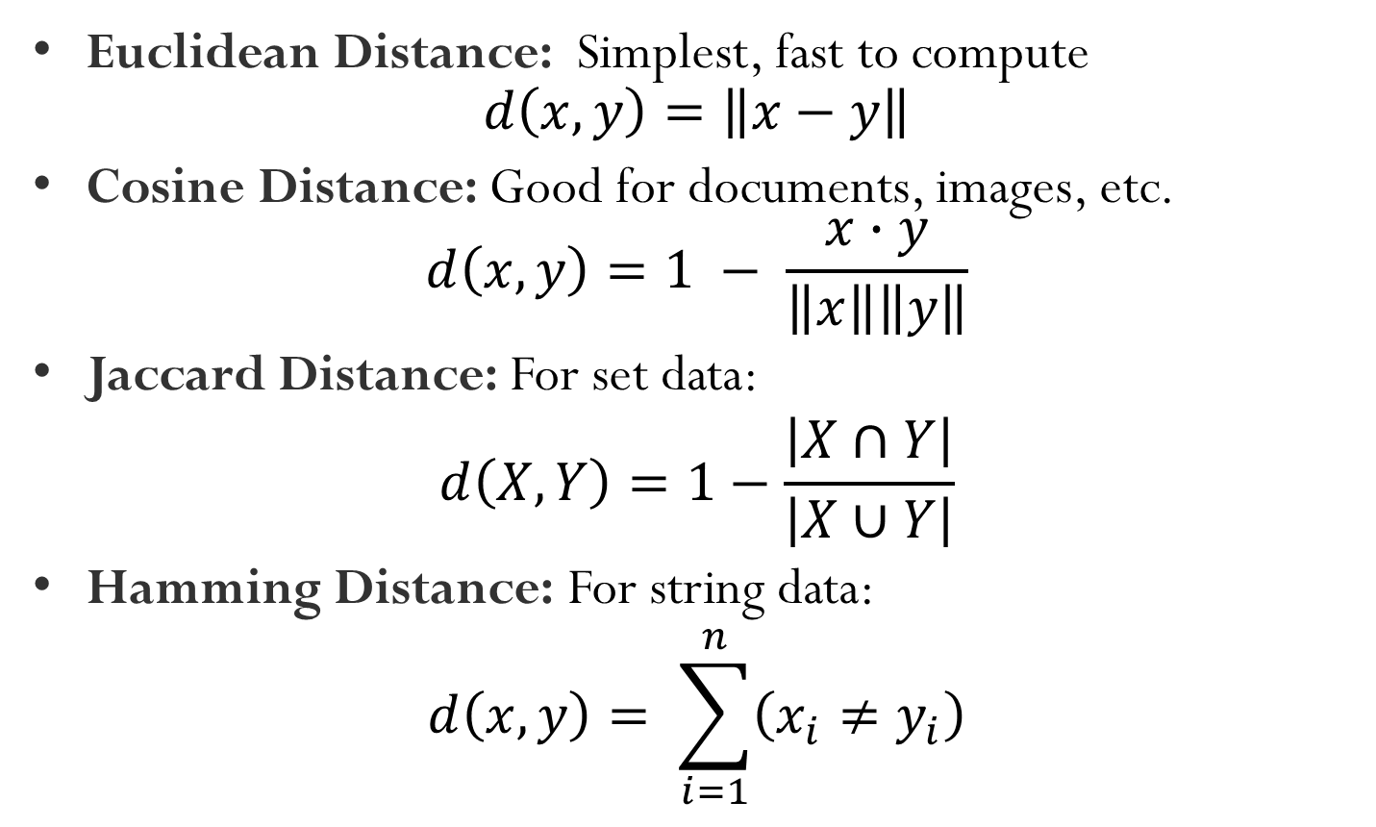
K-NN Metrics
Euclidean Distance: Simplest, fast to compute $d\left(x,y\right)=\left\|x−y\right\|$
Cosine Distance: Good for documents, images, etc. $d\left(x,y\right)=1 − \frac{x∙y}{\left\|x\right\|\left\|y\right\|}$
Jaccard Distance: For set data:
$$d\left(X,Y\right)=1−\frac{\left|X∩Y\right|}{\left|X∪Y\right|}$$
Hamming Distance: For string data:
$$d\left(x,y\right)= \sum_{i=1}^{n}{\left(x_{i}≠y_{i}\right)}$$

Slide 101
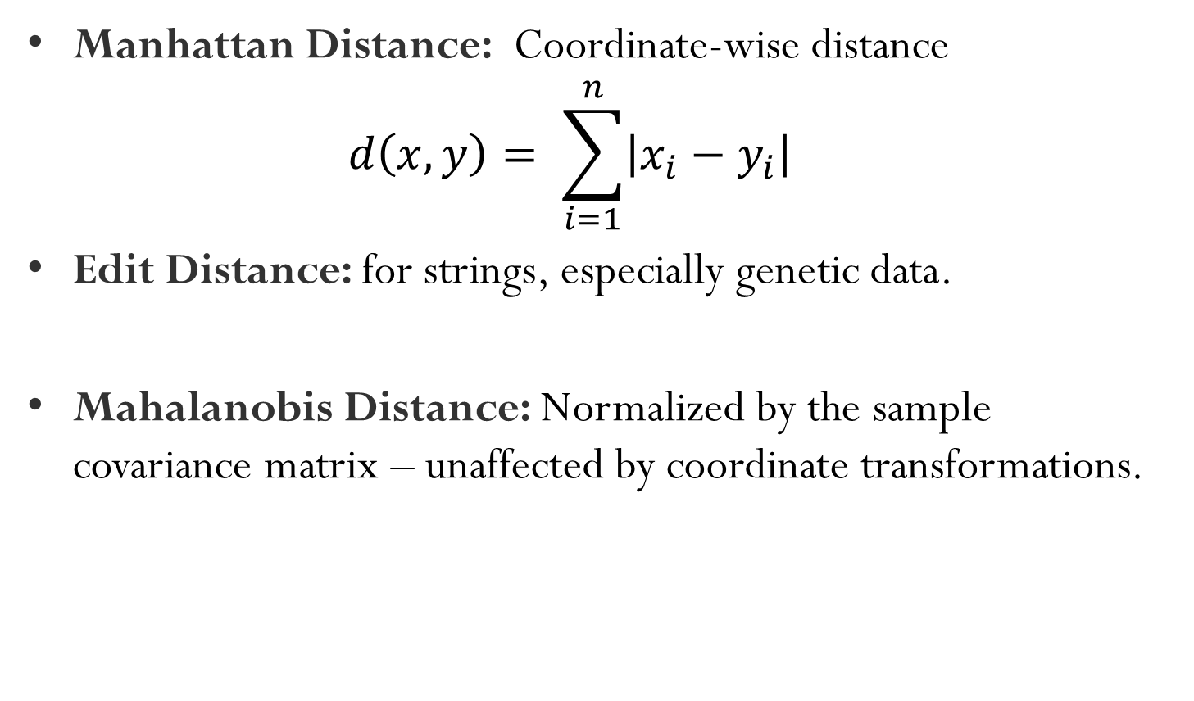
K-NN Metrics
Manhattan Distance: Coordinate-wise distance $d\left(x,y\right)= \sum_{i=1}^{n}{\left|x_{i}−y_{i}\right|}$
Edit Distance: for strings, especially genetic data.
Mahalanobis Distance: Normalized by the sample covariance matrix – unaffected by coordinate transformations.

Slide 102
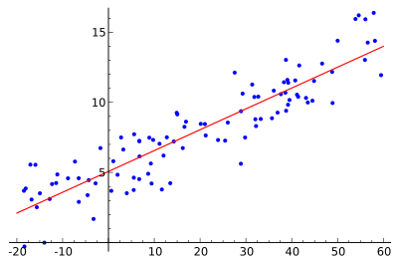
Linear Regression
We want to find the best line (linear function y=f(X)) to explain the data.
X

Slide 103
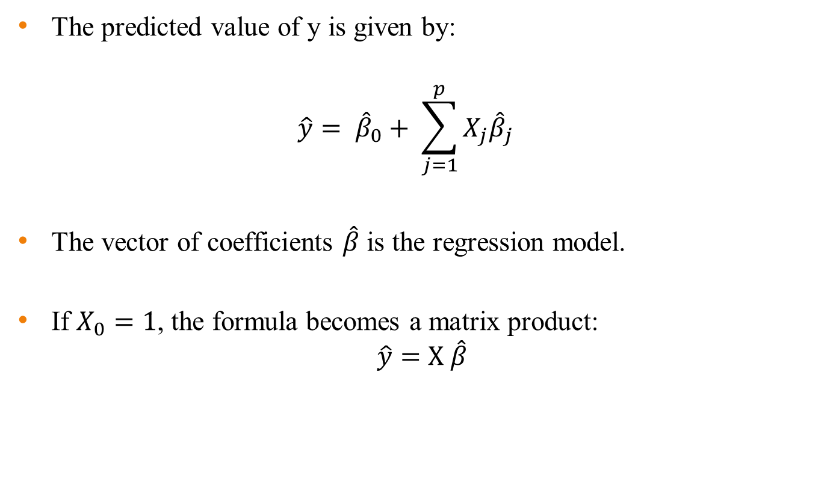
Linear Regression
The predicted value of y is given by:
$$\hat{y}= {\hat{β}}_{0}+ \sum_{j=1}^{p}{X_{j}{\hat{β}}_{j}}$$
The vector of coefficients $\hat{β}$ is the regression model.
If $X_{0}=1$, the formula becomes a matrix product:
$$\hat{y}=X \hat{β}$$

Slide 104
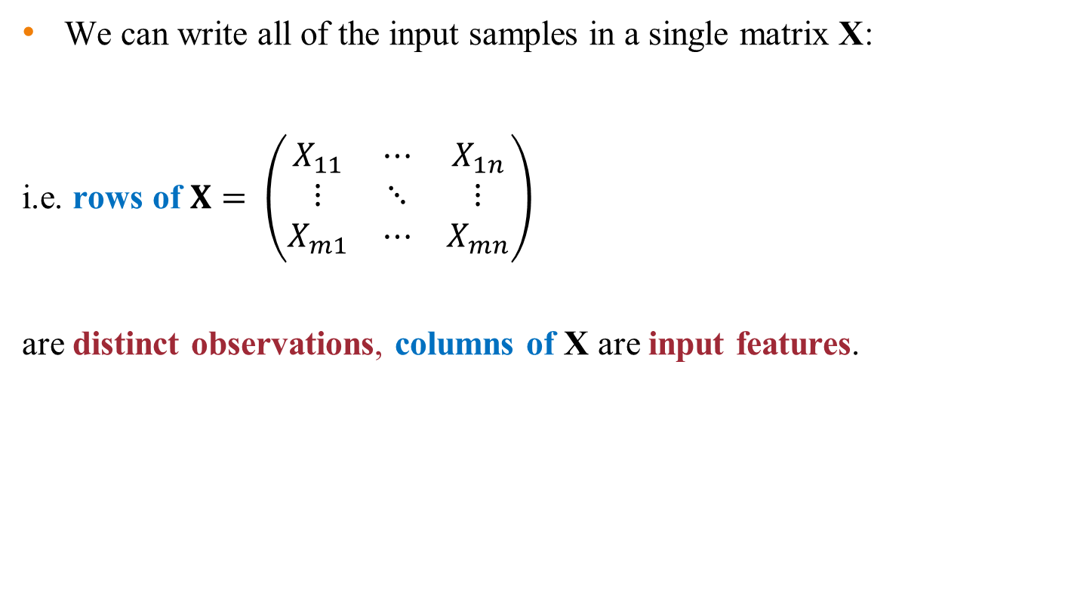
Linear Regression
We can write all of the input samples in a single matrix X:
i.e. rows of $X= \left(\begin{matrix}X_{11} & ⋯ & X_{1n} \\ ⋮ & ⋱ & ⋮ \\ X_{m1} & ⋯ & X_{mn}\end{matrix}\right)$
are distinct observations, columns of X are input features.

Slide 105
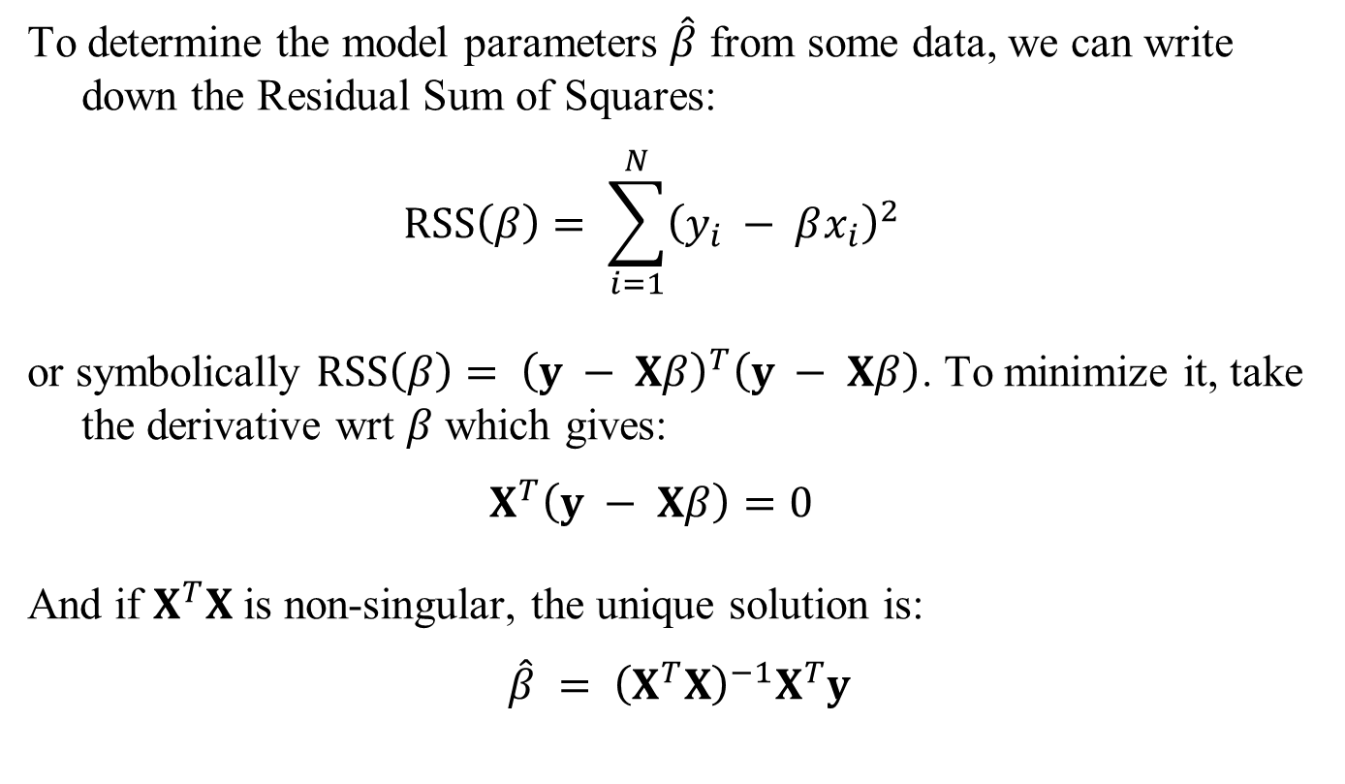
Residual Sum-of-Squares
To determine the model parameters $\hat{β}$ from some data, we can write down the Residual Sum of Squares:
$$RSS\left(β\right)= \sum_{i=1}^{N}{{\left(y_{i} − βx_{i}\right)}^{2}}$$
or symbolically $RSS\left(β\right)= {\left(y − Xβ\right)}^{T}\left(y − Xβ\right)$. To minimize it, take the derivative wrt $β$ which gives:
$$X^{T}\left(y − Xβ\right)=0$$
And if $X^{T}X$ is non-singular, the unique solution is:
$$\hat{β} = {\left(X^{T}X\right)}^{−1}X^{T}y$$

Slide 106
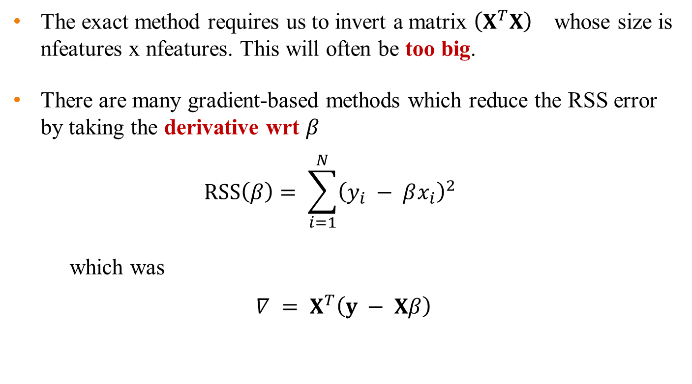
Iterative Regression Solutions
The exact method requires us to invert a matrix ${\left(X^{T}X\right)}^{}$ whose size is nfeatures x nfeatures. This will often be too big.
There are many gradient-based methods which reduce the RSS error by taking the derivative wrt $β$
$$RSS\left(β\right)= \sum_{i=1}^{N}{{\left(y_{i} − βx_{i}\right)}^{2}}$$
which was
$$∇ = X^{T}\left(y − Xβ\right)$$

Slide 107
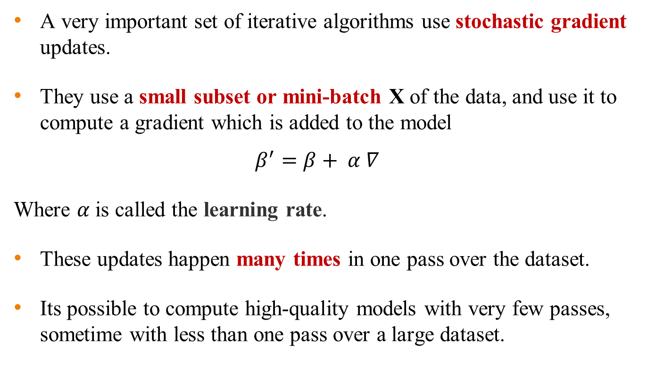
Stochastic Gradient
A very important set of iterative algorithms use stochastic gradient updates.
They use a small subset or mini-batch X of the data, and use it to compute a gradient which is added to the model
$$β^{′}=β+ α ∇$$
Where $α$is called the learning rate.
These updates happen many times in one pass over the dataset.
Its possible to compute high-quality models with very few passes, sometime with less than one pass over a large dataset.

Slide 108
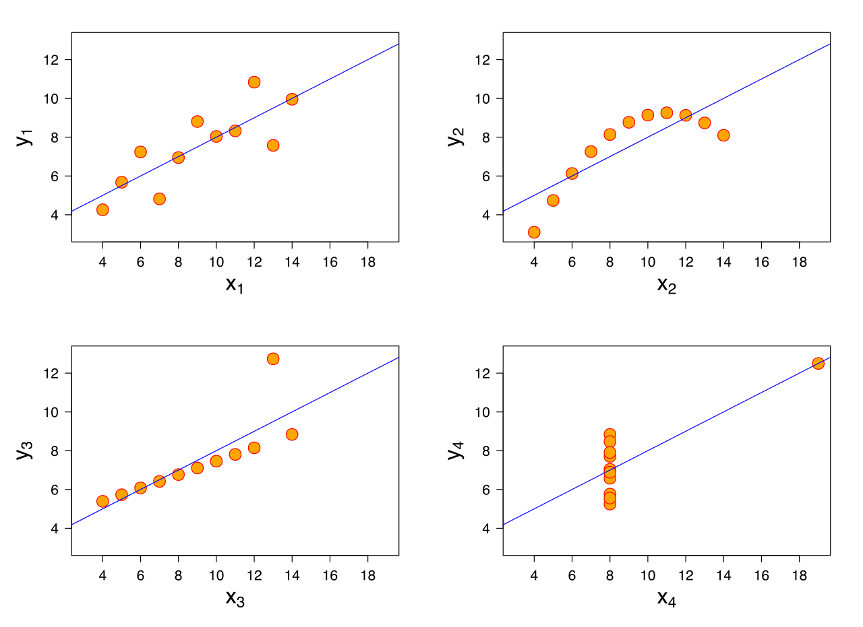
R²-values and P-values
We can always fit a linear model to any dataset, but how do we know if there is a real linear relationship?

Slide 109

R²-values and P-values
Approach: Use a hypothesis test. The null hypothesis is that there is no linear relationship (β = 0).
Statistic: Some value which should be small under the null hypothesis, and large if the alternate hypothesis is true.
R-squared: a suitable statistic. Let $\hat{y}=X \hat{β}$ be a predicted value, and $\overline{y}$ be the sample mean. Then the R-squared statistic is
$$R^{2}=1− \frac{\sum{{\left(y_{i}−\hat{y_{i}}\right)}^{2}}}{\sum{{\left(y_{i}−\overline{y}\right)}^{2}}}$$
And can be described as the fraction of the total variance not explained
by the model.

Slide 110



R-squared
Small if good fit
$$R^{2}=1− \frac{\sum{{\left(y_{i}−\hat{y_{i}}\right)}^{2}}}{\sum{{\left(y_{i}−\overline{y}\right)}^{2}}}$$
Line of $\hat{y}$
Line of $\overline{y}$
X

Slide 111
R²-values and P-values
Statistic: From R-squared we can derive another statistic (using degrees of freedom) that has a standard distribution called an F-distribution.
From the CDF for the F-distribution, we can derive a P-value for the data.
The P-value is, as usual, the probability of observing the data under the null hypothesis of no linear relationship.
If p is small, say less than 0.05, we conclude that there is a linear relationship.

Slide 112
Tree and Bayesian
network

Slide 113

Decision tree learning
Aim: find a small tree consistent with the training examples
Idea: (recursively) choose "most significant" attribute as root of (sub)tree

Slide 114
Decision Tree Construction Algorithm
Principle
Basic algorithm (adopted by ID3, C4.5 and CART): a greedy algorithm
Tree is constructed in a top-down recursive divide-and-conquer manner
Iterations
At start, all the training tuples are at the root
Tuples are partitioned recursively based on selected attributes
Test attributes are selected on the basis of a heuristic or statistical measure (e.g, information gain)
Stopping conditions
All samples for a given node belong to the same class
There are no remaining attributes for further partitioning majority voting is employed for classifying the leaf
There are no samples left

Slide 115
Decision Tree Induction: Training Dataset
This follows an example of Quinlan’s ID3 (Playing Tennis)

Slide 116

Example

Slide 117

Example contd.,

Slide 118

Example contd.,

Slide 119

Example contd.,

Slide 120

Example contd.,

Slide 121

Example contd.,

Slide 122

Example contd.,

Slide 123
Tree Induction
Greedy strategy.
Split the records based on an attribute test that optimizes certain criterion.
Issues
Determine how to split the records
How to specify the attribute test condition?
How to determine the best split?
Determine when to stop splitting

Slide 124

Choosing an attribute
Idea: a good attribute splits the examples into subsets that are (ideally) "all positive" or "all negative"
Patrons? is a better choice

Slide 125
How to determine the Best Split
Greedy approach:
Nodes with homogeneous class distribution are preferred
Need a measure of node impurity:
Non-homogeneous,
High degree of impurity
Homogeneous,
Low degree of impurity

Slide 126
Measures of Node Impurity
Information Gain
Gini Index
Misclassification error
Choose attributes to split to achieve minimum impurity

Slide 127
Attribute Selection Measure: Information Gain (ID3/C4.5)
Select the attribute with the highest information gain
Let p_{i} be the probability that an arbitrary tuple in D belongs to class C_{i}, estimated by |C_{i, D}|/|D|
Expected information (entropy) needed to classify a tuple in D:
Information needed (after using A to split D into v partitions) to classify D:
Information gained by branching on attribute A

Slide 128
Information gain
For the training set, p = n = 6, I(6/12, 6/12) = 1 bit
Consider the attributes Patrons and Type (and others too):
Patrons has the highest IG of all attributes and so is chosen by the DTL algorithm as the root

Slide 129

Example contd.,
Decision tree learned from the 12 examples:
Substantially simpler than “true” tree---a more complex hypothesis isn’t justified by small amount of data

Slide 130
Measure of Impurity: GINI (CART, IBM Intelligent Miner)
Gini Index for a given node t :
(NOTE: p( j | t) is the relative frequency of class j at node t).
Maximum (1 - 1/n_{c}) when records are equally distributed among all classes, implying least interesting information
Minimum (0.0) when all records belong to one class, implying most interesting information

Slide 131
Splitting Based on GINI
Used in CART, SLIQ, SPRINT.
When a node p is split into k partitions (children), the quality of split is computed as,
where,n_{i} = number of records at child i,= number of records at node p.

Slide 132
Comparison of Attribute Selection Methods
The three measures return good results but
Information gain:
biased towards multivalued attributes
Gain ratio:
tends to prefer unbalanced splits in which one partition is much smaller than the others
Gini index:
biased to multivalued attributes
has difficulty when # of classes is large
tends to favor tests that result in equal-sized partitions and purity in both partitions

Slide 133
Example Algorithm: C4.5
Simple depth-first construction.
Uses Information Gain
Sorts Continuous Attributes at each node.
Needs entire data to fit in memory.
Unsuitable for Large Datasets.
You can download the software from Internet

Slide 134
Decision Tree Based Classification
Advantages:
Easy to construct/implement
Extremely fast at classifying unknown records
Models are easy to interpret for small-sized trees
Accuracy is comparable to other classification techniques for many simple data sets
Tree models make no assumptions about the distribution of the underlying data : nonparametric
Have a built-in feature selection method that makes them immune to the presence of useless variables

Slide 135
Decision Tree Based Classification
Disadvantages
Computationally expensive to train
Some decision trees can be overly complex that do not generalise the data well.
Less expressivity: There may be concepts that are hard to learn with limited decision trees

Slide 136
Overfitting and Tree Pruning
Overfitting: An induced tree may overfit the training data
Too many branches, some may reflect anomalies due to noise or outliers
Poor accuracy for unseen samples
Two approaches to avoid overfitting
Prepruning: Halt tree construction early—do not split a node if this would result in the goodness measure falling below a threshold
Difficult to choose an appropriate threshold
Postpruning: Remove branches from a “fully grown” tree—get a sequence of progressively pruned trees
Use a set of data different from the training data to decide which is the “best pruned tree”

Slide 137
What is a Bayesian Network ?
Bayesian nets (BN) -network-based framework for representing and analyzing models involving uncertainty;
BN are different from other knowledge-based systems tools because uncertainty is handled in a mathematically rigorous yet efficient and simple way
BN are different from other probabilistic analysis tools because of
network representation of problems, use of Bayesian statistics, and the synergy between these
A graphical model that efficiently encodes the joint probability distribution for a large set of variables
Naïve Bayes is based on assumption of conditional independence
Bayesian networks provide a tractable method for specifying dependencies among variables

Slide 138
Why learn Bayesian networks?
Combining domain expert knowledge with data
Efficient representation and inference
Incremental Learning
Handling missing data
Learning causal relationships

Slide 139






What Bayesian Networks are good for?
cause
Diagnosis: P(cause|symptom)=?
Prediction: P(symptom|cause)=?
Classification: max P(class|data)
Decision-making (given a cost function)
symptom
class
Stock market
Bio-informatics
Computer
troubleshooting
Speech
recognition
Text
Classification
Medicine

Slide 140
App. : Recommendation Systems
Given user preferences, suggest recommendations
Example: Amazon.com
Input: movie preferences of many users
Solution: model correlations between movie features
Users who like comedy, often like drama
Users who like action, often do not like cartoons
Users who like Robert Deniro films often like Al Pacino films
Given user preferences, can predict probability that new movies match preferences

Slide 141
Sample of General Product Rule
X₁
X₂
X₃
X₅
X₄
X₆
p(x₁, x₂, x₃, x₄, x₅, x₆) = p(x₆ | x₅) p(x₅ | x₃, x₂) p(x₄ | x₂, x₁) p(x₃ | x₁) p(x₂ | x₁) p(x₁)

Slide 142
Terminology
A Bayesian Belief Network describes the probability distribution over a set of random variables Y₁, Y₂, …Y_{n}
Each variable Y_{i} can take on the set of values V(Y_{i})
The joint space of the set of variables Y is the cross product
V(Y₁) × V(Y₂) ×… × V(Y_{n})
Joint probability distribution: specifies the probabilities of the items in the joint space
A Bayesian Network provides a way to describe the joint probability distribution in a compact and structured manner.
A set of random variables makes up the nodes of the network
A set of directed links or arrows connects pairs of nodes. The intuitive meaning of an arrow from X to Y is that X has a direct influence on Y- direct dependence

Slide 143
Bayesian Networks
Requires that graph is acyclic (no directed cycles - DAG)
Each node has a conditional probability table that quantifies the effects that the parents have on the node. The parents of a node are all those nodes that have arrows pointing to it.
2 components to a Bayesian network
The graph structure (conditional independence assumptions)
The numerical probabilities (for each variable given its parents)

Slide 144
Bayesian Networks-The Joint Probability Distribution
Due to the Markov condition, we can compute the joint probability distribution over all the variables X₁, …, X_{n} in the Bayesian net using the formula:
The full joint distribution
The graph-structured approximation
Where Parents(X_{i}) means the values of the Parents of the node X_{i} with respect to the graph

Slide 145
Bayesian Networks
Smart
conditional probability table (CPT)
Good Writer
W
S
P(Q| W, S)
w
s
0.6
0.4
Reviewer
Mood
Quality
w
s
0.3
0.7
w
s
0.4
0.6
w
s
0.1
0.9
Review
Length
Accepted
nodes = domain variables
edges = direct causal influence
Network structure encodes conditional independencies:
I(Review-Length , Good-Writer | Reviewer-Mood)

Slide 146
BN Semantics
W
S
conditional
independencies
in BN structure
local
CPTs
full joint
distribution
over domain
M
Q
+
=
L
A
Compact & natural representation:
nodes ≤ k parents ⇒ O(2^{k} n) vs. O(2^{n}) params
natural parameters

Slide 147
Reasoning in BNs
Full joint distribution answers any query
P(event | evidence)
Allows combination of different types of reasoning:
Causal: P(Reviewer-Mood | Good-Writer)
Evidential: P(Reviewer-Mood | not Accepted)
Intercausal: P(Reviewer-Mood | not Accepted, Quality)
W
S
M
Q
L
A

Slide 148
Bayesian Belief Networks (BNs)
A Bayesian network is made up of:
1. A Directed Acyclic Graph
A
2. A set of tables for each node in the graph
B
C
D
A | P(A)
false | 0.6
true | 0.4
A | B | P(B|A)
false | false | 0.01
false | true | 0.99
true | false | 0.7
true | true | 0.3
B | D | P(D|B)
false | false | 0.02
false | true | 0.98
true | false | 0.05
true | true | 0.95
B | C | P(C|B)
false | false | 0.4
false | true | 0.6
true | false | 0.9
true | true | 0.1

Slide 149
A Directed Acyclic Graph
Each node in the graph is a random variable
A node X is a parent of another node Y if there is an arrow from node X to node Y eg. A is a parent of B
A
B
C
D
Informally, an arrow from node X to node Y means X has a direct influence on Y

Slide 150
A Set of Tables for Each Node
A | B | P(B|A)
false | false | 0.01
false | true | 0.99
true | false | 0.7
true | true | 0.3
A | P(A)
false | 0.6
true | 0.4
A
Each node X_{i} has a conditional probability distribution
P(X_{i} | Parents(X_{i}))
that quantifies the effect of the parents on the node
The parameters are the probabilities in these conditional probability tables (CPTs)
B
B | C | P(C|B)
false | false | 0.4
false | true | 0.6
true | false | 0.9
true | true | 0.1
C
D
B | D | P(D|B)
false | false | 0.02
false | true | 0.98
true | false | 0.05
true | true | 0.95

Slide 151
A Set of Tables for Each Node
Conditional Probability Distribution for C given B
B | C | P(C|B)
false | false | 0.4
false | true | 0.6
true | false | 0.9
true | true | 0.1
For a given combination of values of the parents (B in this example), the entries for P(C=true | B) and P(C=false | B) must add up to 1
eg. P(C=true | B=false) + P(C=false |B=false )=1
If you have a Boolean variable with k Boolean parents, this table has 2^{k+1} probabilities (but only 2^{k} need to be stored)

Slide 152
Using a Bayesian Network Example
Using the network in the example, suppose you want to calculate:
P(A = true, B = true, C = true, D = true)
= P(A = true) * P(B = true | A = true) *
P(C = true | B = true) P( D = true | B = true)
= (0.4)*(0.3)*(0.1)*(0.95)
A
This is from the graph structure
B
C
D
Using a Bayesian network to compute probabilities is called inference
In general, inference involves queries of the form:
P( X | E )
These numbers are from the conditional probability tables
X = The query variable(s)
E = The evidence variable(s)

Slide 153

Example
Topology of network encodes conditional independence assertions:
Weather is independent of the other variables
Toothache and Catch are conditionally independent given Cavity

Slide 154
Independence
P(A|G) = P(A) A ⊥ G
P(G|A) = P(G) G ⊥ A
P(A,G) = P(G)P(A)
Age
Gender
P(A,G) = P(G|A) P(A) = P(G)P(A)
P(A,G) = P(A|G) P(G) = P(A)P(G)
Age and Gender Independent
Age
Gender
Cancer
Serum Calcium and Lung Tumor are dependent
Smoking
Serum Calcium is independent of Lung Tumor, given Cancer
Serum
Calcium
Lung
Tumor
Cancer
Cancer is independent of Age and Gender given Smoking.
P(L|SC,C) = P(L|C)
Age is dependent on Gender, given Smoking
P(C|A,G,S) = P(C|S) C ⊥ A,G | S

Slide 155
Put it all together
Age
Gender
Non-Descendants
P(A, G, E, S, C, L, SC) =
P(A). P(G)
P(E | A). P(S | A, G)
P(C |E , S)
P(SC | C). P(L | C)
Exposure
to Toxics
Smoking
Parents
Cancer
Cancer is independent of Age and Gender given Exposure to Toxics and Smoking.
Serum
Calcium
Lung
Tumor
Descendants
Cancer is independent of Diet given Exposure to Toxics and Smoking.

Slide 156
Contd.,
Bayesian networks provide a natural representation for (causally induced) conditional independence
Topology + CPTs = compact representation of joint distribution
Generally easy for domain experts to construct

Slide 157
Limitations Of Bayesian Networks
Typically require initial knowledge of many probabilities…quality and extent of prior knowledge play an important role
Significant computational cost(NP hard task)
Unanticipated probability of an event is not taken care of.

Slide 158
Constructing Bayesian Networks

Slide 159
Constructing Bayesian networks
Choose an ordering of variables X₁, … ,X_{n}
2. For i = 1 to n
add X_{i} to the network
select parents from X₁, … ,X_{i-1} such that
P (X_{i} | Parents(X_{i})) = P (X_{i} | X₁, ... X_{i-1})
This choice of parents guarantees:
P (X₁, … ,X_{n}) = π_{i =1} P (X_{i} | X₁, … , X_{i-1}) (chain rule)
= π_{i =1}P (X_{i} | Parents(X_{i})) (by construction)

Slide 160
Bayesian Networks – Example I
P(S)
Smoking
P(C|S)
Cancer
P(
S=no)
0.80
P(S)
P(
S=light)
0.15
P(
S=heavy)
0.05
Smoking=
no
light
heavy
P(C|S)
P(
C=none)
0.96
0.88
0.60
P(
C=benign)
0.03
0.08
0.25
P(
C=malig)
0.01
0.04
0.15

Slide 161
Product Rule
P(C,S)=P(C|S).P(S)
S⇓ C ⇒ | none | benign | malignant
no | 0.768 | 0.024 | 0.008
light | 0.132 | 0.012 | 0.006
heavy | 0.035 | 0.010 | 0.005

Slide 162
Marginalization
P(C,S)=P(C|S).P(S)
S⇓ C⇒ | none | benign | malignant | total
no | 0.768 | 0.024 | 0.008 | 0.800
light | 0.132 | 0.012 | 0.006 | 0.150
heavy | 0.035 | 0.010 | 0.005 | 0.050
total | 0.935 | 0.046 | 0.019
P(Smoke)
P(Cancer)

Slide 163
Bayes Rule Revisited
P(S|C)=P(C|S).P(S)/P(C) = P(C,S)/P(C)
S⇓ C⇒ | none | benign | malignant
no | 0.768/.935 | 0.024/.046 | 0.008/.019
light | 0.132/.935 | 0.012/.046 | 0.006/.019
heavy | 0.035/.935 | 0.010/.046 | 0.005/.019
Cancer= | none | benign | malignant
P(S=no) | 0.821 | 0.522 | 0.421
P(S=light) | 0.141 | 0.261 | 0.316
P(S=heavy) | 0.037 | 0.217 | 0.263

Slide 164

Causes and Bayes’ Rule
Diagnostic inference:
Knowing that the grass is wet,
what is the probability that rain is
the cause?
diagnostic
causal

Slide 165
Example II - Alarm (from Judea Pearl)
You have a new burglar alarm installed at home. It is fairly reliable at detecting a burglary, but also responds on occasion to minor earthquakes.
You also have two neighbors, John and Mary, who have promised to call you at work when they hear the alarm.
John always calls when he hears the alarm, but sometimes confuses the telephone ringing with the alarm and calls then, too.
Mary, on the other hand, likes rather loud music and sometimes misses the alarm altogether.
Given the evidence of who has or has not called, we would like to estimate the probability of a burglary.

Slide 166
Step 1
Determine what the propositional (random) variables should be
Determine causal (or another type of influence) relationships and develop the topology of the network

Slide 167
Example II – Alarm Contd.,
Variables: Burglary, Earthquake, Alarm, JohnCalls, MaryCalls
Network topology reflects "causal" knowledge:
A burglar can set the alarm off
An earthquake can set the alarm off
The alarm can cause Mary to call
The alarm can cause John to call

Slide 168
Topology of Belief Network
Burglary
Earthquake
Alarm
John Calls
Mary Calls

Slide 169
Step 2
Specify a conditional probability table or CPT for each node.
Each row in the table contains the conditional probability of each node value for a conditioning case (possible combinations of values for parent nodes).
In the example, the possible values for each node are true/false.
The sum of the probabilities for each value of a node given a particular conditioning case is 1.

Slide 170
Example II-CPT for Alarm Node
B | E | P(A|B,E)
 |  | True | False
T | T | 0.950 | 0.050
T | F | 0.940 | 0.060
F | T | 0.290 | 0.710
F | F | 0.001 | 0.999

Slide 171
Example II – Alarm Contd.,
P(B)
0.001
P(E)
0.002
Burglary
Earth Quake
B | E | P(A|B,E)
T | T | 0.95
T | F | 0.94
F | T | 0.29
F | F | 0.001
Alarm
A | P(M|A)
T | 0.70
F | 0.01
John Calls
Mary Calls
A | P(J|A)
T | 0.90
F | 0.05

Slide 172
Population-wide ANomaly Detection and Assessment (PANDA)
A detector specifically for a large-scale outdoor release of inhalational anthrax
Uses a massive causal Bayesian network
Population-wide approach: each person in the population is represented as a subnetwork in the overall model

Slide 173
Population-Wide Approach
Anthrax Release
Global nodes
Location of Release
Time of Release
Interface nodes
Person Model
Person Model
Person Model
Each person in the population
Note the conditional independence assumptions
Anthrax is infectious but non-contagious
Structure designed by expert judgment
Parameters obtained from census data, training data, and expert assessments informed by literature and experience

Slide 174
Full Joint Distribution

Slide 175




Conditional Independence in BNs
Three Types of Connections:
Knowing S makes L and B
independent (common cause)
Converging
Knowing T makes
A and X independent
(intermediate cause)
L
Lung
B
Cancer
Bronchitis
NOT knowing D or M makes L and B independent (common effect)

Slide 176
Semantics of Belief Networks
View 1: A belief network is a representation of the joint probability distribution (“joint”) of a domain.
The joint completely specifies an agent’s probability assignments to all propositions in the domain (both simple and complex.)

Slide 177
Example Calculation
Calculate the probability of the event that the alarm has sounded but neither a burglary nor an earthquake has occurred, and both John and Mary call.
P(J ^ M ^ A ^ ~B ^ ~E)
= P(J|A) P(M|A) P(A|~B,~E) P(~B) P(~E)
= 0.90 * 0.70 * 0.01 * 0.999 * 0.998
= 0.00062

Slide 178

Network as representation of joint
A generic entry in the joint probability distribution is the probability of a conjunction of particular assignments to each variable, such as:
Each entry in the joint is represented by the product of appropriate elements of the CPTs in the belief network.

Slide 179
Semantics
View 2: Encoding of a collection of conditional independence statements.
JohnCalls is conditionally independent of other variables in the network given the value of Alarm
This view is useful for understanding inference procedures for the networks.

Slide 180
Causal Inferences
P(E)
P(B)
0.002
0.001
Burglary
Earthquake
B E P(A)
Inference from cause to effect.
E.g. Given a burglary, what is Probability of John Calling -P(J|B)?
T T 0.95
A P(J)
Alarm
T F 0.94
T 0.90
F T 0.29
F 0.05
F F 0.001
John Calls
Mary Calls
A P(M)
T 0.70
F 0.01
P(M|B)=0.67 via similar calculations

Slide 181
Diagnostic Inferences
From effect to cause. E.g. Given that John calls, what is the P(burglary)?
What is P(J)? Need P(A) first:
Many false positives.

Slide 182


Slide 183
Neural Network

Slide 184

Real Neurons
Cell Structure
Cell body (SOMA) 1
-Process the inputs 2
Dendrites
-Accepts the inputs 3
Axon 4
-Turn the processed input to output
Synaptic terminals
-Electro-chemical contacts between neurons

Slide 185

The Neuron Metaphor
Neurons:
The main purpose of neurons is to receive, analyze and transmit further the information in a form of signals (electric pulses).
Multiply inputs by weights along edges
Apply some function to the set of inputs at each node

Slide 186
The goals of neural computation
To understand how the brain actually works
Its big, complicated and made of yucky stuff that dies when you poke it around.
To understand a new style of computation
Inspired by neurons and their adaptive connections.
Different from sequential computation
Good for cognitive process(e.g. vision)
Bad for computation process(e.g. 23 x 71)
To learn practical problems, Learned algorithms is useful even if it doesn’t depict how the brain works

Slide 187
A Neural Network
Can be viewed as a generalization of linear models.
Each ANN is composed of a collection of perceptrons grouped in layers.
A typical structure has three layers: input, intermediate (called the hidden layer) and output.
Several hidden layers can be placed between the input and output layers.

Slide 188
Artificial Neural Network
ANNs are built of densely interconnected set of simple units, each taking several real-valued inputs and producing single-valued output.
ANN is characterized by its architecture, its training or learning algorithm and its activation functions.
One motivation is to capture highly parallel computations on distributed processes.
Most ANN software run on sequential machines emulating distributed processes.

Slide 189
Pros and Cons of Neural Networks
Pros
Good to use in continuous domains with little knowledge.
Ability to solve problems that are difficult to define.
Can be used when a good functional model is not known.
Provides human characteristics to problem solving that are difficult to simulate.
Flexibility and ease of maintenance
Fast processing speed.
Cons
Not interpretable, “black box”.
Learning is slow.
Good generalization can require many data points.

Slide 190
Origin of Neural Networks
To find information processing models of biological systems
Term covers wide range of models
Exaggerated claims of biological plausibility
Biological realism imposes unnecessary constraints
Neural networks are efficient models for machine learning
Particularly multilayer perceptrons
Network parameters are obtained in maximum likelihood framework
A nonlinear optimization problem
Requires evaluating derivative of log-likelihood function w.r.t network parameters
Done efficiently using error back propagation

Slide 191

Types of Neural Network
Feed-forward neural network
Information travel in one direction only
No feedback or cycles – Directed Acyclic graph
Simplest and most used one
Used for pattern recognition
Feed-forward neural network

Slide 192

Types of Neural Network
Recurrent neural network
Signals travel in both directions
Complicated and dynamic
Can use their internal memory to process arbitrary sequences of inputs
Used to learn temporal patterns
Recurrent Neural Network

Slide 193

Types of Neural Network
Linear Neuron
Logistic Neuron
Potentially more. Require a convex loss function for gradient descent training.
Perceptron

Slide 194

Feed Forward Network Functions
A neural network can also be represented similar to linear models but basis functions are generalized.
Activation function:
For regression: identity function
For classification: a nonlinear function e.g., sigmoid
Coefficients w_{j} adjusted during training
There can be several activation functions
Basis functions:
ϕ_{j} (x) a nonlinear function, e.g., tanh, of a linear combination of D inputs
Its parameters are adjusted during training

Slide 195


First Layer: Basis Functions
D input variables x1,.., xD
M linear combinations in the form
Superscript (1) indicates parameters are in first layer of network
• Parameters w_{ji} are referred to as weights and w_{j0} as biases
• Quantities a_{j} are known as activations

Slide 196
First Layer: Basis Functions
Each activation a_{j} is transformed using differentiable nonlinear activation functions z_{j}=h(a_{j})
The z_{j} correspond to outputs of basis functions ϕ_{j}(x)
or first layer of network or hidden units
Nonlinear functions h chosen to be sigmoidal
Two examples of activation functions
1. logistic sigmoid [1/1+exp(-a)]
2. tanh [(eª-e^{-a})/(eª+e^{-a})]

Slide 197

Activation Function
Determined by the nature of the data and the assumed distribution of target variables.
Can use a variety of activation function
Sigmoidal (S-shaped)
Logistic sigmoid [1/1+exp(-a)] (Used for binary classification)
Hyperbolic tangent - tanh
Radial Basis Function

Slide 198

Activation Function
Softmax
(Used for multi-class classification)
Identity y_{k} = a_{k} (Useful for regression)
Needs to be differentiable for gradient-based learning (later).
Can use different activation function in each unit.

Slide 199

Second Layer: Activation Functions
Values z_{j} are again linearly combined to give output unit activations
Where K is the total number of outputs
• Output unit activations are transformed by using appropriate activation function to give network outputs y_{k}

Slide 200

Overall Network Function
Combining stages of the overall function with sigmoidal output
Where w is the set of all weights and bias parameters. Note presence of both σ and h functions
Thus a neural network is simply
a set of nonlinear functions from input variables {x_{i}} to output variables {y_{k}}
controlled by vector w of adjustable parameters

Slide 201

Forward Propagation
Bias parameters can be absorbed into weight parameters by defining a new input variable x₀
Process of evaluation is forward propagation through network
Multilayer perceptron is a misnomer
Since only continuous sigmoidal functions are used

Slide 202
Feed Forward Networks
Connect together a number of these units into a feed-forward network (DAG)
Figure shows a network with one layer of hidden unit
Implements function

Slide 203
Feed Forward Networks
We have looked at generalized linear models of the form:
For fixed non-linear basis function Ø(.)
We now extend this model by allowing adaptive basis function and learning their parameters.

Slide 204

Feed Forward Networks
In feed-forward networks (a.k.a. Multi-layer perceptrons) we let each basis function be another non-linear function of linear combination of the inputs.

Slide 205


Feed Forward Networks
Starting with input x= (x₁,…,x_{D}), construct linear combinations:
These a_{j} are known as activations.
Pass through an activation function h(.)
to get output z_{j}=h(a_{j})
Model of an individual neuron

Slide 206
Representation power of Feed Forward Networks
Depends on the width and depth of the networks
Boolean functions:
Represented by network with two layers of units where the number of hidden units required grows exponentially.
Continuous functions(bounded):
Can be approximated with arbitrarily small error, by network with two layers of units.
Arbitrary functions:
Can be approximated to arbitrary accuracy by a network with three layers of units.

Slide 207

Two-class Classification
Neural Network:
Two inputs, two hidden units with tan h activation functions
Red line:
decision boundary for network
Dashed lines:
contours for two hidden units
Green line:
optimal decision boundary from distributions of the data
Multiple distinct choices for the weight vector w for same mapping function exists.

Slide 208

Network Training
Given a specified network structure, how do we set its parameters (weights)?
As usual, we define a criterion to measure how well our network performs, optimize against it
For regression, training data are (x_{n}, t), t_{n} e R, Squared error arises:

Slide 209


Network Training
For binary classification, this is another discriminative model, ML:

Slide 210

Parameter Optimization: Geometrical View
For either of these problems, the error function E(w) is nasty.
Nasty Non-Convex Local minima
E(w): surface sitting over weight space
w_{A}:a local minimum; w_{B} global minimum
Need to find minimum
At point w_{C} local gradient
is given by vector ∇E(w)
points in direction of greatest rate of increase of E(w)
Negative gradient points to rate of greatest decrease

Slide 211
Neural Network Learning Problem
Goal is to learn the weights w from a labelled set of training samples
Learning procedure has two stages
1. Evaluate derivatives of error function ∇E(w) with respect to weights w₁,..w_{T}
2. Use derivatives to compute adjustments to weights
w^{(t+1)} = w^{(t)}−η∇E(w^{(t)} )
No. of weights is T=(D+1)M+(M+1)K
=M(D+K+1)+K
Where D is no of inputs, M is no of hidden units, K is no of outputs

Slide 212
Descent Methods
The typical strategy for optimization problems of this sort is a descent method:
w^{(t+1)} = w^{(t)} + Δw^{(t)}
These come in many flavours
Gradient descent ∇E(w^{(t)})
w^{(τ+1)}=w^{(τ)}−η∇E(w^{(τ)})
η – the learning rate
Stochastic gradient descent ∇E_{n}(w^{(t)})
w^{(τ+1)}=w^{(τ)}−η∇E_{n}(w^{(τ)})

Slide 213
Descent Methods
Newton-Raphson (second order) ∇²
All of these can be used here, stochastic gradient descent is particularly effective
For good optimization run gradient based algorithm multiple times, using a different starting point every time.
Redundancy in training data, escaping local minima

Slide 214

Computing Gradients
The function y(x_{n} , w) implemented by a network is complicated
It isn’t obvious how to compute error function derivatives with respect to weights
Numerical method for calculating error derivatives, use finite differences:
How much computation would this take with W weights in the network?
O(w) per derivative, O(w2) total per gradient descent step
Use of gradients improves computation speed.

Slide 215
Testing, Evaluation and
Validation of Models

Slide 216
Training, Validation, and Test sets
Training set: A set of examples used for learning, that is to fit the parameters of the classifier.
Validation set: A set of examples used to tune the parameters of a classifier, for example to choose the number of hidden units in a neural network.
Test set: A set of examples used only to assess the performance of a fully-specified classifier.

Slide 217
Evaluating a model
The most important thing we can do to properly evaluate the model is to not train the model on the entire dataset.
A typical train/test split would be to use 70% of the data for training and 30% of the data for testing.
It's important to use new data when evaluating the model to prevent the likelihood of overfitting to the training set. However, sometimes it's useful to evaluate the model as building it to find that best parameters of a model – but can't use the test set for this evaluation or else

Slide 218
Evaluating a model
we'll end up selecting the parameters that perform best on the test data but maybe not the parameters that generalize best.
To evaluate the model while still building and tuning the model, to create a third subset of the data known as the validation set.
A typical train/test/validation split would be to use 60% of the data for training, 20% of the data for validation, and 20% of the data for testing.

Slide 219
Classification Metrics
When performing classification predictions, there's four types of outcomes that could occur.
True positives are when you predict an observation belongs to a class and it actually does belong to that class.
True negatives are when you predict an observation does not belong to a class and it actually does not belong to that class.
False positives occur when you predict an observation belongs to a class when in reality it does not.
False negatives occur when you predict an observation does not belong to a class when in fact it does.

Slide 220


Classification Metrics contd.,
These four outcomes are often plotted on a confusion matrix.
The following confusion matrix is an example for the case of binary classification. Have generate this matrix after making predictions on your test data and then identifying each prediction as one of the four possible outcomes described above.

Slide 221


Three Main Metrics
Accuracy is defined as the percentage of correct predictions for the test data. It can be calculated easily by dividing the number of correct predictions by the number of total predictions.
Precision is defined as the fraction of relevant examples (true positives) among all of the examples which were predicted to belong in a certain class.

Slide 222

Contd.,
Recall is defined as the fraction of examples which were predicted to belong to a class with respect to all of the examples that truly belong in the class.

Slide 223

Precision and Recall

Slide 224

F-score
Combine the precision and recall metrics; the common approach for combining these metrics is known as the f-score.
The ββ parameter allows us to control the tradeoff of importance between precision and recall. β<1β<1 focuses more on precision while β>1β>1 focuses more on recall.

Slide 225
Regression metrics
Evaluation metrics for regression models are quite different than the classification models because we are now predicting in a continuous range instead of a discrete number of classes.
If your regression model predicts the price of a house to be $400K and it sells for $405K, that's a pretty good prediction.
However, in the classification examples we were only concerned with whether or not a prediction was correct or incorrect, there was no ability to say a prediction was "pretty good".
Thus, we have a different set of evaluation metrics for regression models.

Slide 226

Metrics For Regression Models
Explained variance compares the variance within the expected outcomes, and compares that to the variance in the error of our model. This metric essentially represents the amount of variation in the original dataset that our model is able to explain.
Mean squared error is simply defined as the average of squared differences between the predicted output and the true output.

Slide 227

Contd.,
Squared error is commonly used because it is agnostic to whether the prediction was too high or too low, it just reports that the prediction was incorrect.
The R² coefficient represents the proportion of variance in the outcome that our model is capable of predicting based on its features.

Slide 228

Contd.,
R² coefficient

Slide 229
Bias vs Variance
The ultimate goal of any machine learning model is to learn from examples and generalize some degree of knowledge regarding the task we're training it to perform.
Some machine learning models provide the framework for generalization by suggesting the underlying structure of that knowledge.
For example, a linear regression model imposes a framework to learn linear relationships between the information we feed it.

Slide 230

Bias vs Variance Contd.,
However, sometimes we provide a model with too much pre-built structure that we limit the model's ability to learn from the examples - such as the case where we train a linear model on a exponential dataset.
In this case, our model is biased by the pre-imposed structure and relationships.
Models with high bias pay little attention to the data presented; this is also known as underfitting

Slide 231
Validation curves
The goal with any machine learning model is generalization. Validation curves allow us to find the sweet spot between underfitting and overfitting a model to build a model that generalizes well.
A typical validation curve is a plot of the model's error as a function of some model hyperparameter which controls the model's tendency to overfit or underfit the data.
The parameter what we choose depends on the specific model we're evaluating; For example, we might choose to plot the degree of polynomial features (typically, this means you have polynomial features up to this degree) for a linear regression model.

Slide 232

Validation curves Contd.,
Generally, the chosen parameter will have some degree of control over the model's complexity.
On this curve, we plot both the training error and the validation error of the model. Using both of these errors combined, we can diagnose whether a model is suffering from high bias or high variance.

Slide 233
Learning curves
The second tool we'll discuss for diagnosing bias and variance in a model is learning curves. Here, we'll plot the error of a model as a function of the number of training examples. Similar to validation curves, we'll plot the error for both the training data and validation data.
If our model has high bias, we'll observe fairly quick convergence to a high error for the validation and training datasets. If the model suffers from high bias, training on more data will do very little to improve the model.

Slide 234

Learning curves Contd.,
This is because models which underfit the data pay little attention to the data, so feeding in more data will be useless.
A better approach to improving models which suffer from high bias is to consider adding additional features to the dataset so that the model can be more equipped to learn the proper relationships.

Slide 235

Learning curves Contd.,
If the model has high variance, we'll see a gap between the training and validation error. This is because the model is performing well for the training data, since it has been overfit to that subset, and performs poorly for the validation data since it was not able to generalize the proper relationships.
In this case, feeding more data during training can help improve the model's performance.

